Slide 1
Mutualism in the Redwood Forest Ecosystem!

Slide 2
Organism and Ecosystem
What is an organism?
What is an ecosystem?

Slide 3
What is mutualism?
A mutualistic relationship is when two different organisms work together or depend on each other. They form a relationship that is beneficial to both parties.

Slide 4
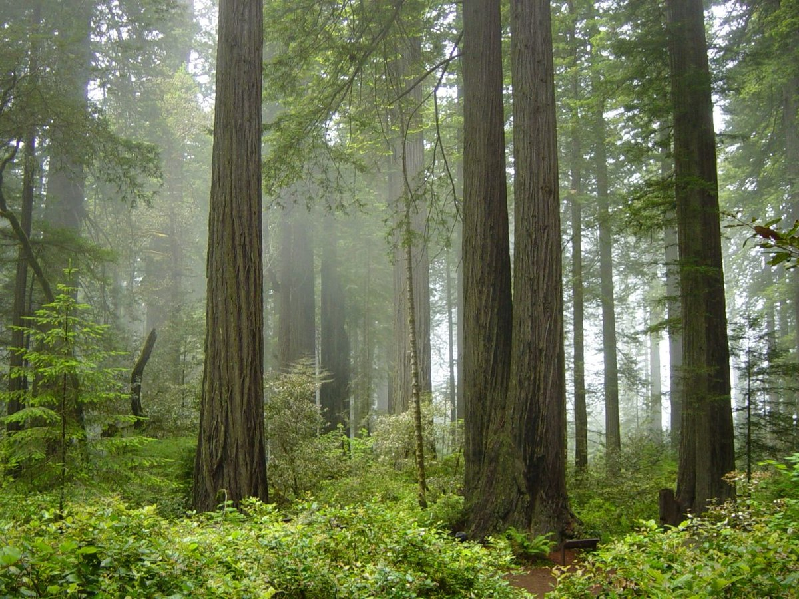
What do you think lives in the Redwood Forest?
Image Description: Fog in a redwood forest

Slide 5
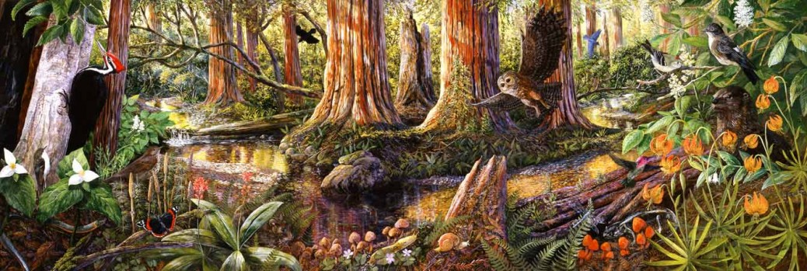
Let's look at Mutualism in the redwood forest!
Image Description: A painting of the redwood forest and the creek with different animals and plants

Slide 6
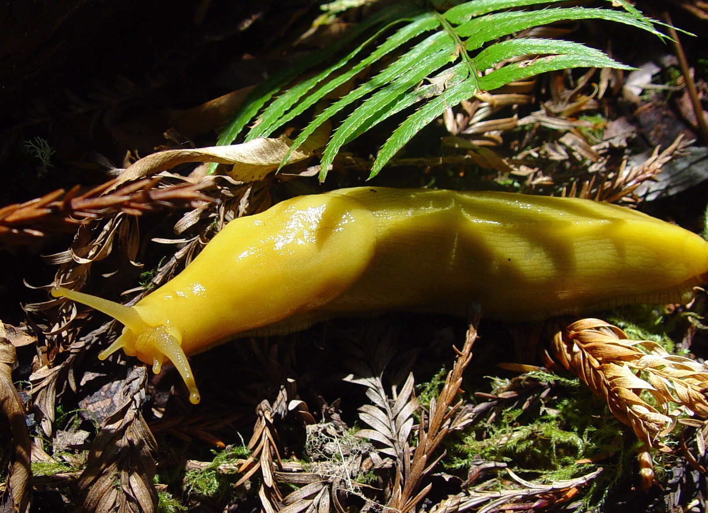
Banana Slugs and Redwood Trees
Banana slugs live in the redwood forest and have a wonderful relationship with the redwood trees! Banana slugs need their skin to stay wet, so they like to live in wet places away from the sun. Redwood trees give them a damp place to live. The trees give them shade and water from the fog.
Banana slugs help the trees too! Banana slugs are decomposers, which means they break down dead material. This means they eat fallen leaves or animal poop and turn it into a nutrient rich soil for the redwoods to use. This is why they have a mutualistic relationship!
Image Description: A banana slug on the forest floor

Slide 7
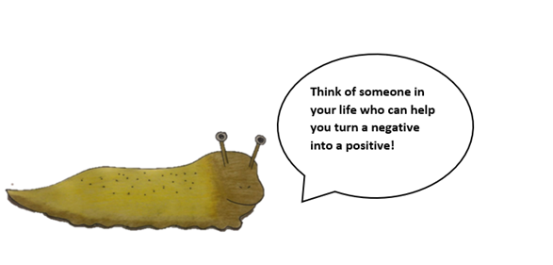
Banana Slug
Image Description: A drawing of a banana slug saying “Think of someone in your life who can help you turn a negative into a positive.”

Slide 8
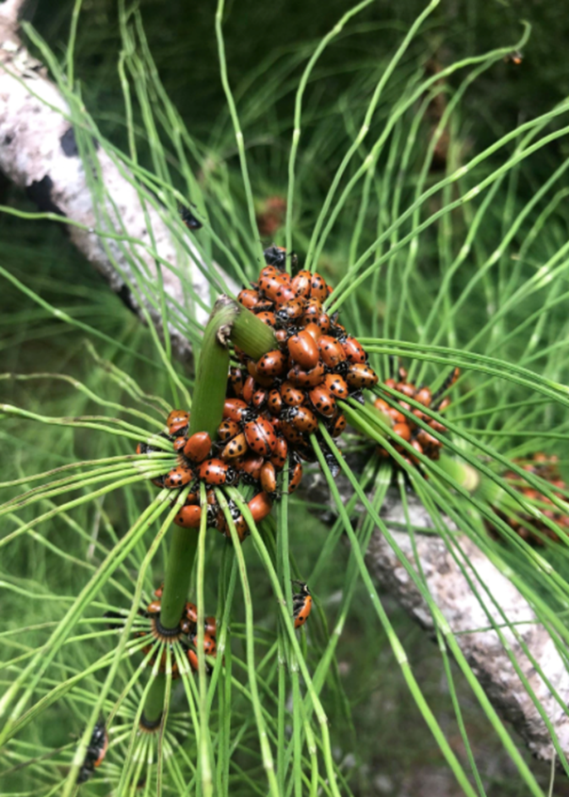
Ladybugs and Horsetails:
Ladybugs come to Muir Woods as a get away from changing weather. They gather on the horsetail. The horsetail gives them shelter, water that can collect on the needles and food. Aphids are small insects that can hurt a horsetail, but luckily ladybugs love to eat aphids. This makes the ladybug and horsetail relationship have benefits for both. They have a mutualistic relationship.
The horsetail is a safe place for the ladybugs to land, and the ladybugs help to relieve the horsetail ferns of their pests. They are there for each other when they need each other.
Image Description: A group of ladybugs clustering on a horsetail.

Slide 9
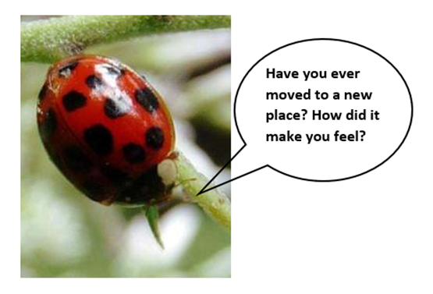
Ladybug
Image Description: A picture of a ladybug saying “Have you ever moved to a new place? How did it make you feel?

Slide 10
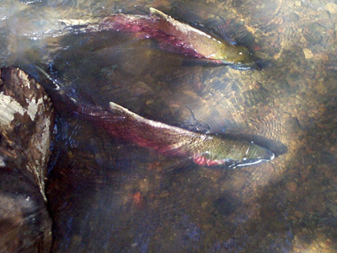
Coho Salmon and The Redwood Trees:
Redwoods often grow along creeks. They will help to shade the creek and keep it cool. They keep soil from going into the creek and muddying the water. When their branches or trunks fall into the creek, it helps to slow the water down and create pools. All these things make for a better habitat for the Coho Salmon.
Coho salmon go from the creek to the ocean and back again. When salmon go out to the ocean, they get a lot of important nutrients from the things they eat. When they come back to lay their eggs, they will die in the creek. After they die they will decompose and the nutrients they brought from the ocean become a part of the redwood forest ecosystem and help the redwoods to grow.
Image Description: Two coho salmon swimming in the creek.

Slide 11
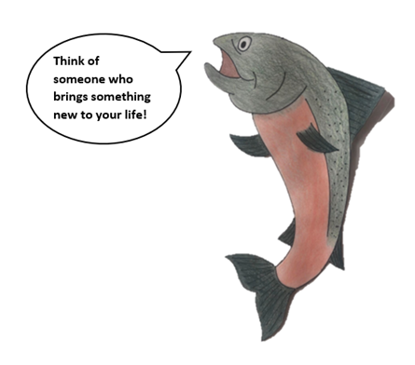
Salmon
Image Description: A drawing of a coho salmon saying “Think of someone who brings something new to your life!”

Slide 12
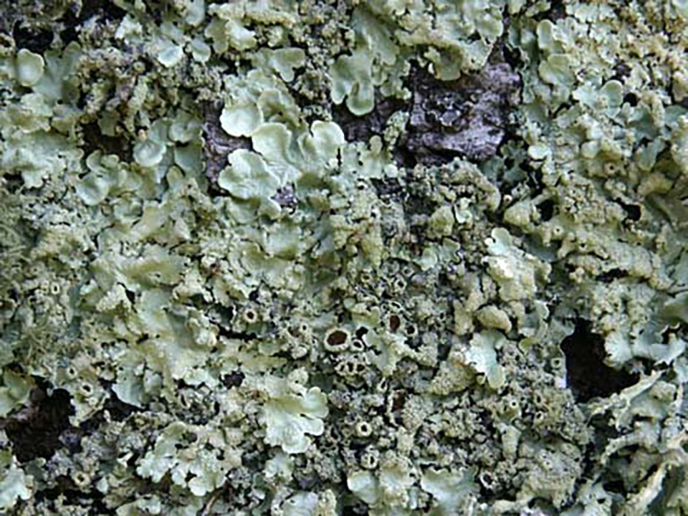
Lichen
Lichen is not one thing, but many things that exist together!
Lichen is made up of different kinds of fungus and algae. The fungus creates the structure and provides nutrients. The algae makes food and energy from sunlight and water for itself and the fungus. Therefore, they have a mutualistic relationship.
Without all these components, lichen would not exist. All the different organisms are a part of this team.
Image Description: Green lichen on a rock

Slide 13
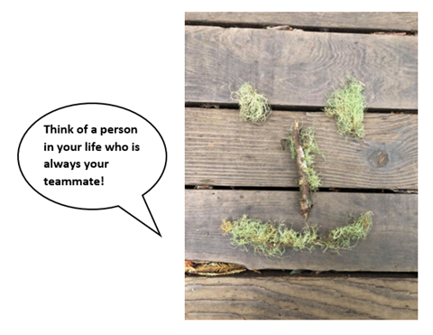
Lichen
Image Description: Lichen arranged like a smiley face says, “Think of a person in your life who is always your teammate!”

Slide 14
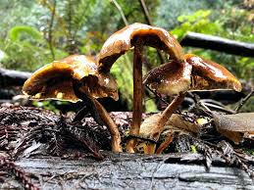
Mushrooms and Trees
When you see a mushroom, you are only seeing a very small part of it! That is because most of it lives underground, in what’s called the mycelium.
This mycelium plays an important role in how trees talk to each other. Scientists believe these mushrooms connect to tree roots underground and get important food and energy from the tree roots. In return the mushrooms connect the tree to other trees around them, helping trees to talk with each other.
Image Description: Mushrooms grow out of a redwood log

Slide 15
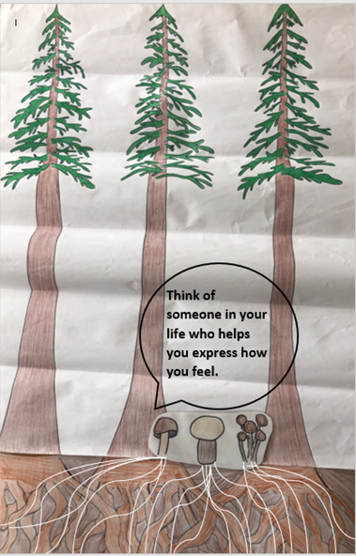
Mushrooms
Image Description:
A drawing of three redwood trees and their roots are connected with three mushrooms and their mycelium underground. The mushrooms say “Think of someone in your life who helps you express how you feel.”

Slide 16
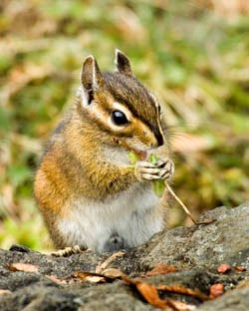
Animals and Berries
There are different kinds of berries throughout the redwood forest. Some of these berries can be dangerous for us to eat, but are fine for animals like chipmunks, birds and squirrels. These small animals will eat the berries, and then carry their seeds to another place. This is called seed dispersal. This helps everyone, it is food for the small animals and helps the plant to spread its seeds and grow in new places. That is why this is a mutualistic relationship.
Image Description: A chipmunk eats seeds on a rock

Slide 17
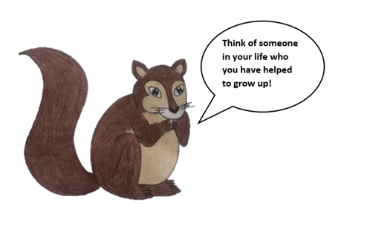
Squirrel
Image Description: A drawing of a squirrel says, “Think of someone in your life who you have helped to grow up!”

Slide 18
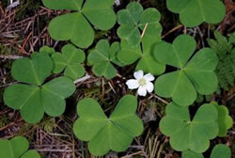
Sorrel and the Redwood Trees
When you look around the redwood forest, you may see what you think is a lot of clover. But it is something different. It’s called redwood sorrel.
Redwood sorrel is a shade loving plant. Redwood trees provide that shade for the sorrel. In return, the sorrel provides covers the forest floor and helps to make sure that the soil stays in place. One single sorrel by itself can’t keep the soil in place. One redwood by itself can’t provide enough shade. The forest needs every redwood tree and every sorrel.
Image Description: Redwood sorrel and flower on the forest floor.

Slide 19
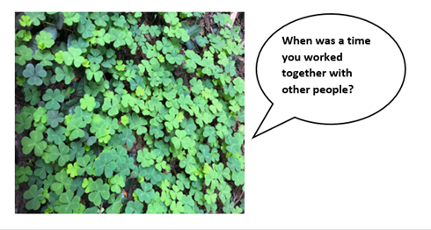
Sorrel
Image Description: A picture of redwood sorrel says, “When was a time you worked together with other people?”

Slide 20
Diversity
All of the relationships are very different, as are the organisms in the relationships. There is a lot diversity in the redwood forest ecosystem.
What is diversity?

Slide 21
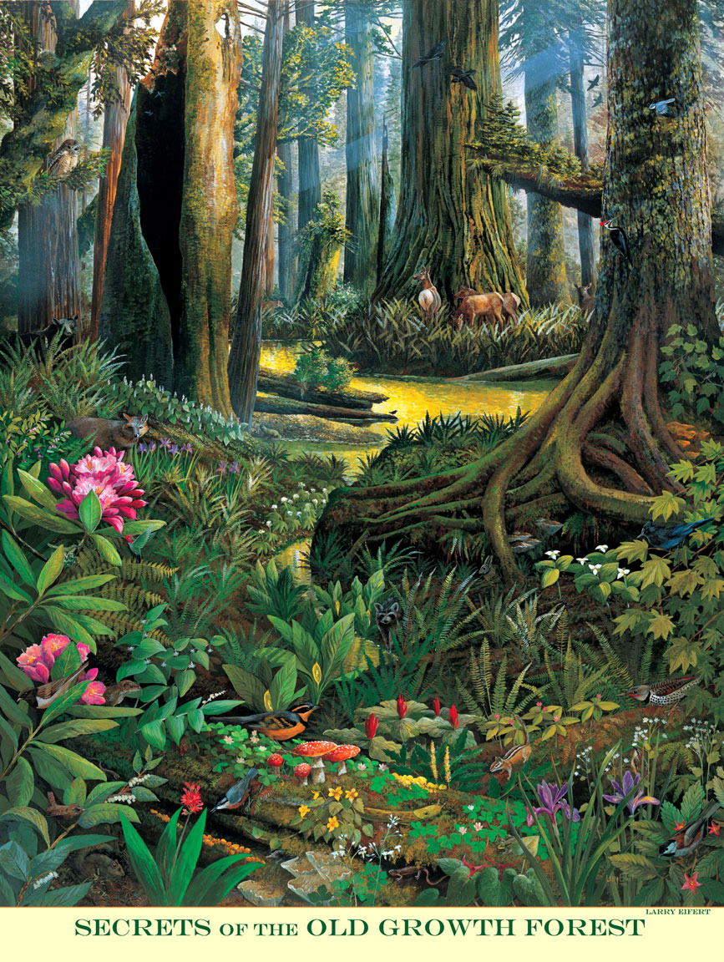
Strength
How does diversity make this forest stronger?
How does diversity make your community stronger?
Image Description: A painting of the redwood forest and the creek.

