Slide 1
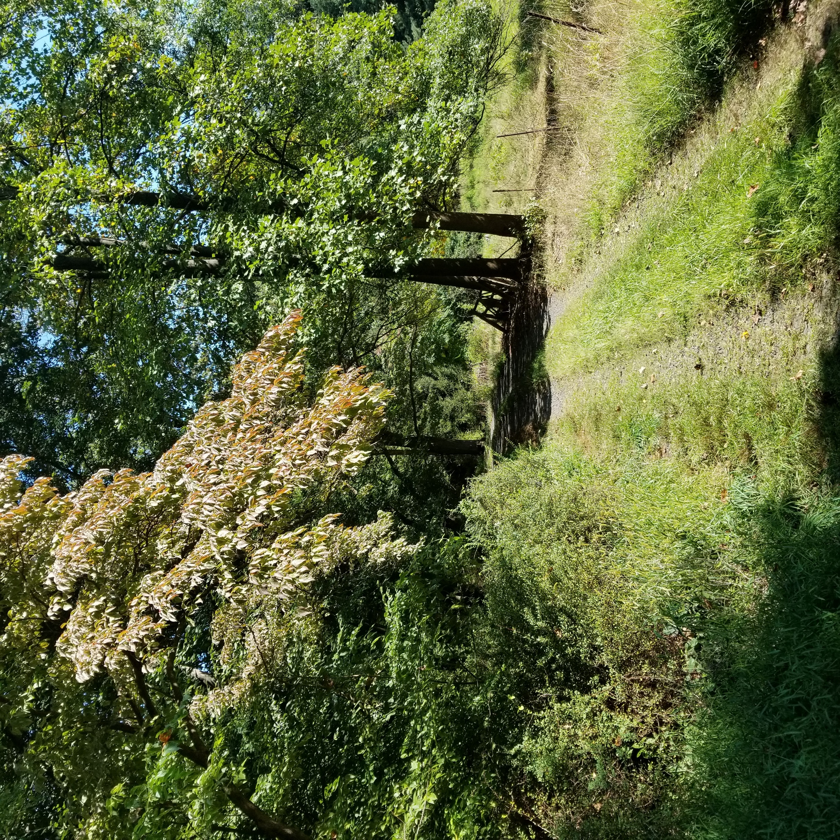
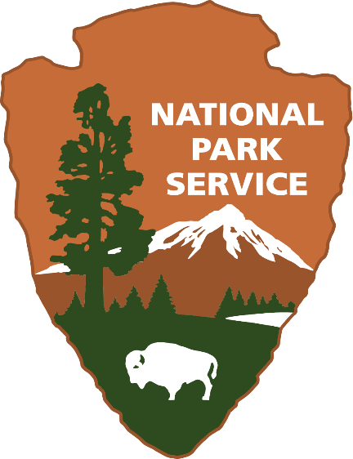
Amplifying Indigenous Voices in Battlefield Preservation
Webinar
December 9, 2020
Notes:
Introductions: speaker intro and what we’re going to cover – grants from the ABPP with a focus on preservation planning grants, new eligibility guidance, and a commitment and invitation to open up spaces for indigenous voices and projects that contribute to the preservation of places significant to the histories and cultures of indigenous peoples. I’d like to start out with a few examples of the kinds of questions these grants have helped answer, and invite participants to think about what sorts of questions are important to you and your communities.
(Image is from a BLAG)

Slide 2
“What Have We Overlooked?”
In 2017-2020, the University of Montana’s highly collaborative grant-funded project aimed to define a battlefield centering Indigenous ways of knowing.
The project brought together non-Native and Apsáalooke (Crow) researchers, elders, and institutions to document a battlefield landscape and history defined by spiritual events and places.
Notes:
One 2017 grant application asked the central question here: its original title was “What have we overlooked?”
The University of Montana used a 2017 grant to complete a study of how spirituality and spiritual landscapes shaped battlefield strategies and histories on the Northern Plains. This collaborative project was led by both Native and non-Native researchers, partnering with the Crow Tribe, elders, Salish Kootenai College, and Little Big Horn College. The project centered Apsáalooke (Crow) perspectives on Ashkoota Binnaxchikua/Where The Camp Was Fortified, also known as the Battle of Arrow Creek, which occurred between Apsalooke and allied Arapaho, Cheyenne, and Sioux forces in 1863-1864 as settler incursions disrupted Native territories and food security. According to Apsaalooke traditions, the history of this battle is interlaced with places, events, and visions that connect battlefield landscapes with spiritual understandings of the past and present. This project recognized that in answering the fundamental question of “where is the battlefield?,” indigenous cultural knowledge is vital for our collective understandings of what happened, where it happened, and why it was important. This project created a case study for an indigenous definition of the battlefield landscape and events that the researchers hope will keep this heritage, which was so carefully preserved for over 150 years, from being overlooked in cultural heritage preservation efforts.
From “What have we overlooked?” this grant’s final report was titled “Where They Fought,” which sums up the success of this project in centering Native voices, and leads us to ask, what stories do YOU want to remember? (Image: University of Montana)

Slide 3
Why Do Battlefields Matter?
From 2016-2018, the Seneca Nation led research to locate the 1779 Bucktooth Run Battlefield, a Revolutionary War site in the Seneca Nation’s Allegany Territory.
The grant funded historical research, oral history, and remote sensing. The study focused on what the campaign meant for the long term history of the Seneca Nation.
Notes:
Another question is “why and how do these histories matter?”
The Seneca Nation received a 2016 grant to produce a historical study and archeological research design for the Bucktooth Run Battlefield, the site of a 1779 Revolutionary War engagement in the Seneca Nation’s Allegany territory in today’s New York state. Seneca people recorded stories of the destruction of towns and cornfields during this campaign, but American military records minimized this event, leading to questions over whether it occurred. One goal of this grant was to reconcile historical narratives that minimized the battle and locate the battlefield to shed light on a period in history that the Seneca consider a source of loss and intergenerational trauma. The grant’s activities included remote sensing in an attempt to locate battlefield features, review of historical documentation and oral histories, and recommendations for future archeological study. The oral history and social science research stressed the importance of the war in Seneca history and memory, and suggested ways to interpret contradictory sources about the battle in ways that reconciled the historical and oral records. While the archeological research on the battlefield was inconclusive, the project showed the importance of using multiple sources of knowledge to understand history from multiple perspectives, and recognizing that “independence” was not the war’s only outcome.
We encourage applications for such projects that elevate the meanings and legacies of conflicts like the American Revolution for Native nations. Why a battlefield matters depends on who is asking, and who is answering. (Photo: Doug Perelli 2018 for Seneca Nation)

Slide 4
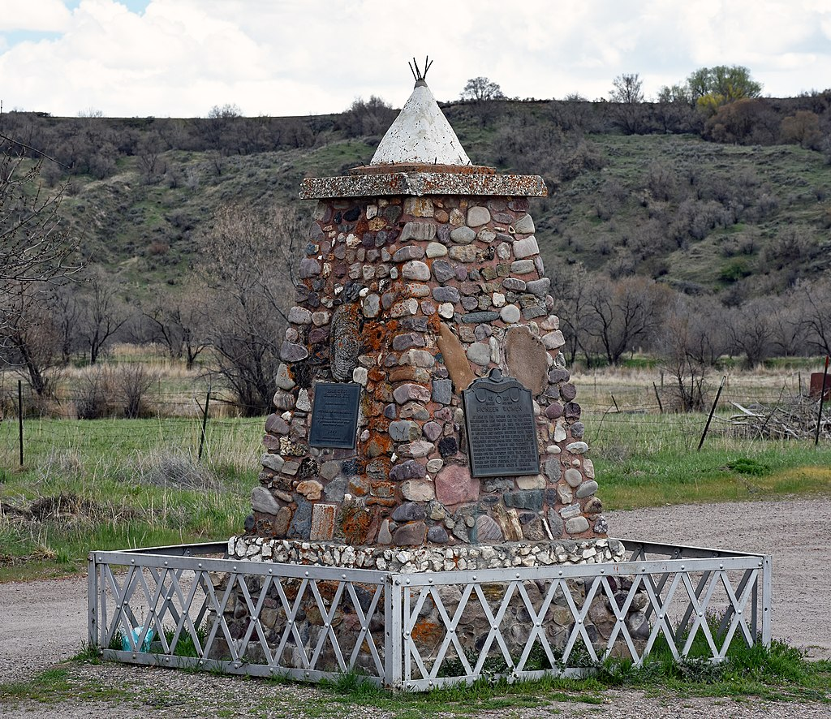
How Do You Want to Tell Your Story?
The Northwestern Bands of the Shoshone Nation received a 2017 grant to assist with preservation planning for the Bear River Massacre Site, or Boa Ogoi, site of a January 1863 Massacre. The preservation planning process will help chart next steps for managing the site and telling its story from Native perspectives.
Notes:
And then, how do you want to tell your story?
At the site, known as Boa Ogoi or the Bear River Massacre site in Idaho, the U.S. army attacked and killed between 250-500 Shoshone people in January of 1863. The US government designated the site of this tragic massacre as a National Historic Landmark. Local settlers established a monument in 1932, depicted here, which provides the most visible and dominant story of the landscape (image from Wikipedia by Beneathtimp). As Chairman Darren Parry of the Northwestern Bands of the Shoshone Nation has written about the narrative it presents, “It is like a view from a window that has been carefully placed to exclude a whole quadrant of a beautiful landscape.” This monument only tells one perspective of the history, and is not inclusive of the Northwestern Shoshone’s experience of the massacre. A 2017 grant to the Northwestern Shoshone is being used for preservation planning for the site in a way that seeks to recognize more Native memories of this event, which Chairman Parry points out are not monolithic either, as every family was impacted in a different way. The Northwestern Shoshone have acquired some portions of the site, and ABPP’s grant supports their efforts to illuminate more of that landscape by developing a preservation plan that can be used by Tribal leaders, landholders and preservationists to find agreement and action in preserving and protecting this important place.
(Image: Wikimedia commons)

Slide 5
A Scope Defined by US History
Notes:
All of these projects show that questions of what have we overlooked, why do these places matter, and how do you want to tell the story are ones Native people bring particular knowledge and experience to answering.
These stories give a few examples of how the scope of these grants match the scope of American history, as defined by their establishing legislation, which broadly includes the armed conflicts that shaped the history of the United States. Preserving sites associated with armed conflict also means recognizing the centrality of Indigenous people this nation’s history, whether in the violence of colonization, the participation of Native people in the American armed forces, or their enduring connections to their ancestral lands. To date, preservation planning grants have funded work ranging from Spanish conflicts with indigenous people in the 16th century southwest and Florida, to the 17th century conflicts known as the Pequot War and King Philip’s War in the northeast, to the many impacts of the American Revolution on Native peoples, to the nineteenth century’s battles to control Native territories in the west. Furthermore, many battlefields are large cultural landscapes that remain culturally and environmentally important today. Documenting and preserving the state of these battlefield landscapes can be a part of larger strategies for conservation and use for communities who may value these lands for present as well as historical reasons.
Preservation is not limited to physical protection of a property “frozen in time” – education, community involvement, storytelling, and generally understanding and protecting what makes places important to people can all qualify. These grants can provide financial assistance for people and communities to care for places that matter to them, based on their own identification of their needs and with minimal federal involvement.
Image: Fort Ticonderoga, needs credit

Slide 6
American Battlefield Protection Program
The National Park Service’s American Battlefield Protection Program (NPS ABPP) assists citizens, public and private institutions, and governments in planning, interpreting, and protecting sites where historic battles were fought on American soil during the armed conflicts that shaped the growth and development of the United States.
Legislative Authority: 54 U.S.C. § 308102
Notes:
First, I’d like to tell you who we are. The ABPP is a national program authorized by Congress and administered by the NPS for the purpose of… (read) We’re a program with seven staff, and our offices are in Washington, DC. You can reach us easily at abpp@nps.gov, and my last slide will include contact information.
Image: Gettsyburg - probably an NPS photo?

Slide 7
Battlefield Preservation Grant Programs
Preservation Planning | Land Acquisition | Interpretive Modernization* | Battlefield Restoration*
Annual, competitive | Rolling | Annual, competitive | TBD
No match | 50% match | 50% match | 50% match
All periods of history | Rev War, 1812, Civil War | Rev War, 1812, Civil War | Rev War, 1812, Civil War
Planning, research, and outreach activities excluding bricks-and-mortar preservation or restoration work | Land acquisition by state and local governments | Reimagining battlefield interpretation using technology – planning and implementation level | Restoration of landscapes to day-of-battle conditions, including plans and studies
$1.9 million per year | $10-13 million/year | Up to $1 million/year | Up to $1 million/year
*Authorized but not yet an active funding opportunity
Notes:
NPS ABPP currently administers two grant programs, and two more were established in the 2019 National Defense Authorization Act. We anticipate that they will be funded and become active in FY2021. Here is a quick comparison. We will be focusing on Preservation Planning Grants today because they are the only grants that can be applied to any armed conflict on American soil, regardless of whether the United States had been founded or the US Army was involved in the battle.

Slide 8
Grant Basics
Battlefield Preservation Planning Grants fund documentation, research, planning, partnership building, interpretation, and outreach
Projects can focus on battlefields and associated sites from any period in American history
Grants are awarded annually through a competitive merit review process
Typical awards range from $30,000-$100,000, and no match is required
Grant projects should be completed in two years

Slide 9
Eligible Applicants
State and local governments
Public and private institutes of higher education
Nonprofits having a 501(c)(3) status
Federally recognized Native American tribal governments, other Native American tribal organizations, and Native Hawaiian Organizations

Slide 10
Definitions
1. Eligible activities must focus on planning, interpreting, and preserving
sites associated with armed conflicts that shaped the growth and
development of the United States.
  Armed conflicts = periods of collective violence, characterized by specific events and bounded in time
2. Projects must contribute to the preservation of battlefields or associated sites that are thematically tied with events that occurred during an armed conflict.
Themes for associated sites:
  Military
  Government, Law, Politics, and Diplomacy
  Intellectual History
  Economics of War
  Society
  Transportation
Notes:
Will give a couple of examples of armed conflicts involving Native peoples that we have recently funded, that also exemplify project activities people might not think of as “preservation,” but that we believe contribute to stewardship.
Now, we haven’t given a clear definition of associated sites for these grants previously, so there are fewer funded examples, but I’d like to discuss a few types of potentially eligible sites that aren’t battlefields per se. These might include fortified settlements or dwelling sites communities protected or moved to, features of the landscape that were important for transportation, defense, or food supply, sites of government during conflicts, and related places of spiritual importance as in the University of Montana’s project. We are open to creative proposals applying this definition in historically grounded ways to projects that will be innovative for our program. Full definitions will be available in on our website and the grants.gov funding opportunity announcement.

Slide 11
Eligible Activities
Consultation and partnerships
Collections stewardship
Education
Historical documentation
Exhibitions, media, and signage
Planning
Public programs and outreach
Survey and inventory

Slide 12
What is Not Eligible?
Lobbying and fundraising
Land acquisition
Capital projects or bricks and mortar preservation work
Battle reenactments
Activities that could harm a battlefield’s integrity (e.g. large scale archeological data recovery, metal detection without a research design)
Research unrelated to place-based preservation and stewardship
Projects unrelated to battlefields and associated sites
Notes:
Plus anything else that is unallowable under 2 CFR 200
Projects on federal land or using federal resources can be funded if they meets the regulatory standards for financial assistance. That means that it can’t involve funding activities that are of direct benefit to the federal government, there must be a public purpose outside of the agency’s work to fulfill its mission. Unlike a cooperative agreement, a grant-funded project should not be controlled by a federal agency, it should be driven by the non-federal applicant. If you are considering working with a federal partner, your points of contact may be able to provide clarification about how to navigate this given the specifics of your project, and NPS ABPP can also help answer questions about eligibility.

Slide 13
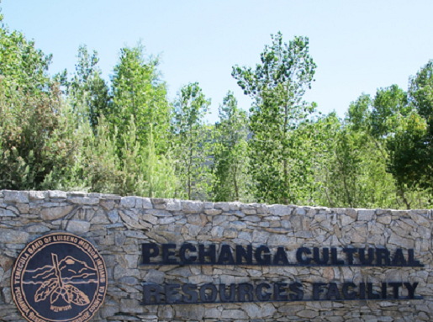
Pechanga Band of Indians Planning Grant
Temecula Massacre Battlefield and Cemetery Documentation (2018)
  Armed conflict: Mexican-American War
  Preservation goals: Identification & documentation of massacre site and associated cemetery, commemoration through documentary film
Eligible Activities:
  Site survey and inventory
  Archival research and oral history interviews
  Production of documentary film
Notes:
The site of the Temecula Massacre of 1846 is a very sensitive site to the Pechanga Band, where many of their ancestors died. Identifying the resources associated with the massacre is an important step toward preserving them, especially since they are not all on tribal land. Additionally, the grant includes funding for a documentary film about the battle and its resonance for the Tribe, which is an activity that might not immediately occur to everyone as preservation-oriented, so we wanted to highlight this. All of these activities are eligible because they contribute to site-based preservation.
We’d also like to note multiple ways to consider the site’s eligibility. Previous eligibility guidelines had said that a site had to be directly connected to a specific battle, so the application identified Temecula Massacre as a result of Battle of San Pasqual, 1846. However, we fielded many questions from applicants and partners about ambiguity in this guidance, e.g. whether a site of collective violence like a massacre, or a fort designed for protection during a lengthy armed conflict, would be eligible. The current guidelines in our Notice of Funding Opportunity have an expanded explanation of site eligibility based on our founding legislation. We have clarified that the program funds place-based preservation projects at historic sites of and associated with armed conflicts on American soil. That would make this massacre site eligible as a site of collective violence during the Mexican-American War, as well as its connection to the Battle of San Pasqual.
(Image needs credit, do not use on social media)

Slide 14
Pueblo of Isleta Planning Grant
Archeological Investigation of Ancestral Tiwa Battle Sites (2019)
  Armed conflicts: Spanish contact and colonial period encounters
  Preservation goals: Archeological research and documentation of two Tiwa-Piro battle sites, community engagement
Eligible Activities:
  Archeological and historical research
  Youth participation in field and/or lab work
  Community engagement to share findings
Notes:
The Pueblo of Isleta received a grant in 2019 to conduct archeological documentation and preservation of two archeological sites, the Ancestral Tiwa pueblo of Pottery Mound and the Ancestral Piro pueblo of Sevilleta. The THPO wrote in the application that this area is underrepresented in written histories and very much of interest to communities today: “People at Isleta wish to obtain and preserve any type of knowledge about their ancestors’ life under colonial rule and the causes behind the disappearance of the Piros as a group and the loss of all but two Ancestral Tiwa pueblos.” Prior research at these sites found metal objects, mostly armor and munitions, and indications of structural fires. The research will help uncover probable histories of conflict from the Spanish contact and early colonial periods of the 16th and 17th centuries. Eligibility for these grants under the umbrella of “armed conflict” can encompass sites like these that are not sites of well documented battles, where grant-funded research can increase our understanding of underrepresented periods of conflict, and bring more Native perspectives to narratives of colonial history. I also want to highlight that both the archeological documentation and community outreach elements of this project are considered preservation activities.
(Image is from another federal agency, allowable on social media)

Slide 15
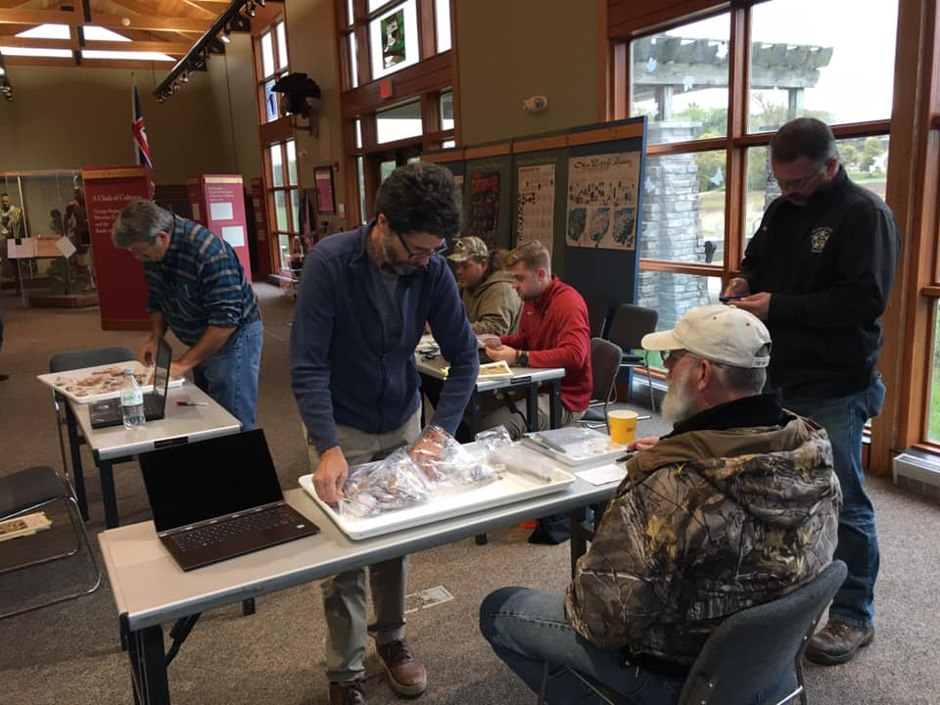
Ball State University Planning Grants
Battle of Peckuwe Site Identification, Documentation, and Public Outreach (2018, 2020)
  Armed conflict: Battle of Peckuwe (1780), Revolutionary War
  Preservation goals: Identification & documentation of battlefield boundaries, interpretation & education
Eligible Activities:
  Archeological and historical survey
  Interpretation and education in partnership with Clark County Parks
  Communication with interested tribes before and throughout project
Notes:
Ball State University’s Archaeology and Applied Anthropology Laboratories has received multiple planning grants for work on battlefields in the Midwest, which I’d like to discuss as an example of best practices for non-Native applicants. Two recent grants in 2018 and 2020 have focused on archeological survey to research the Revolutionary War battle of Peckuwe and the extension of settlers into today’s Ohio. While this project is led by non-Native researchers, they have worked to build relationships with tribes like the Eastern Shawnee and Shawnee Tribe of OK who are part of this history, starting with seeking tribal input prior to applying and continuing to communicate throughout the projects. We know this through letters of support from the tribes.
The NPS ABPP invites tribes to consult on our grantmaking activities under Section 106 of the National Historic Preservation Act, and we see over and over that when non-Native applicants start building these relationships early, and the Section 106 initiation letter is not the first time a tribal leader or THPO hears about a project, this leads to better relationships and a greater chance for indigenous perspectives to shape the project. This is relevant for any conflict, since Native ancestral lands and Native people were involved in the Revolutionary War, Civil War, World War II, and others people might not initially think of. If you would like to propose a project and are not sure how to find tribes with interest in the area, your SHPO can help. Please also be aware that you can apply for a grant just to work on building these relationships prior to starting a larger project. (Image: Ball State University)

Slide 16
Review & Award Timeline*
February 12, 2021: Application deadline
February/March 2021: Initial review for eligibility and completeness
Initiation of Section 106 review
March/April 2021: Competitive merit review
April/May 2021: Risk assessment
Budget & scope negotiation (if needed)
June 2021: Grants awarded
July 2021: Grant agreements signed, projects can begin
*This timeline may be subject to change

Slide 17
How to Apply
Search on Grants.gov: CFDA #15.926, or program name
Download application package from Grants.gov:
  Notice of Funding Opportunity
  Standard application forms
Complete and submit through Grants.gov Workspace

Slide 18
Application Components
Grants.gov standard forms:
  SF-424 - Application for Financial Assistance
  SF-424A - Budget Information – Non-Construction Programs
  SF-424B - Assurances – Non-Construction Programs
  SF-LLL – Disclosure of Lobbying Activities???
Project Narrative
Budget Narrative
Map
Indirect Cost Rate Agreement, if applicable
Other supporting documents

Slide 19
Merit Review
Criteria | Value
1. Preservation Opportunity | 20 points
2. FY2021 Focus Areas | 10 points
3. Objectives & Activities | 20 points
4. Administration & Implementation | 20 points
5. Partnerships & Engagement | 20 points
6. Secretary of the Interior Priorities | 10 points
Highest Possible Total Score | 100 points
Notes:
FY2021 Focus Areas:
Projects that focus on underrepresented sites and stories, or enhance our understanding of the origins of the United States. Special thematic priority will be given to applications that address the histories and legacies of those who experienced the armed conflicts that led to American independence (for example, the “Pueblo Revolt”, the American Revolutionary War, or “Nat Turner’s Rebellion”), and that preserve associated historic sites as a living part of community life and development. I emphasize that a broad historical conception of “the armed conflicts that led to American independence” can in many ways turn our attention to conflicts on and over Native lands.
(Note: will try to add in pop-ups for what each criterion is before delivering)

Slide 20
Program Goals
Broaden the pool of new applicants, especially with expanded guidance on eligible armed conflicts and associated sites
Fund projects and organizations telling the full American story from diverse perspectives
Highlight underrepresented program areas: Indigenous-led projects, associated sites, sites west of the Mississippi, Black history
Notes:
Our goals for FY2021 include
Geographic: west of Mississippi
Community-led: Identifying Native-led projects and strong partnership projects to amplify indigenous voices in the interpretation and preservation of their own history
Historical: associated sites
In review, This year’s funding competition will be starting in the coming weeks [date if we have one], and application materials will be available at grants.gov. We’ve received some great applications for projects focusing on indigenous histories, and look forward to expanding to fund more inclusive preservation approaches and stories directed by communities and their needs. We don’t have all the answers but we hope to lend the tools we have to others who do. We really want to hear from you.
Plug for other webinars

Slide 21
Feedback Opportunity
  We want to hear from you!
  Do you have advice for NPS ABPP on how to make this funding opportunity relevant and feasible for Native nations and organizations?
  What potential barriers do you see in applying for this funding?
  We welcome any other feedback, advice, and suggestions from today’s audience.

Slide 22
Q&A
  What questions do you have?

Slide 23
Contact us any time!
abpp@nps.gov
Philip Bailey: (202) 513-7126
Emily Button Kambic: (202) 354-2035
https://www.nps.gov/abpp
Thank You
Questions?
.
..

