Slide 1

Nat & Parker
Get Their
Theodore Roosevelt Inaugural Site
Junior Ranger Badges!

Slide 2
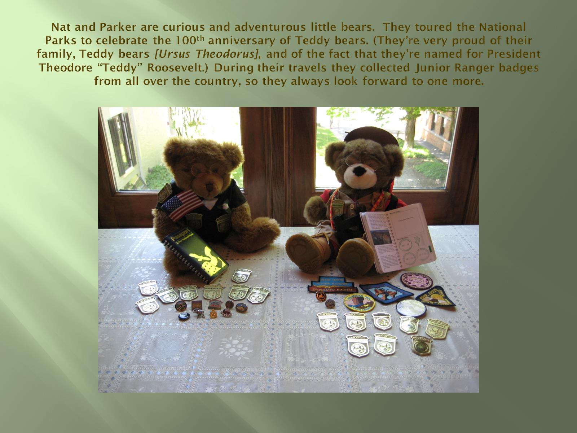
Nat and Parker are curious and adventurous little bears. They toured the National Parks to celebrate the 100th anniversary of Teddy bears. (They’re very proud of their family, Teddy bears [Ursus Theodorus], and of the fact that they’re named for President Theodore “Teddy” Roosevelt.) During their travels they collected Junior Ranger badges from all over the country, so they always look forward to one more.

Slide 3
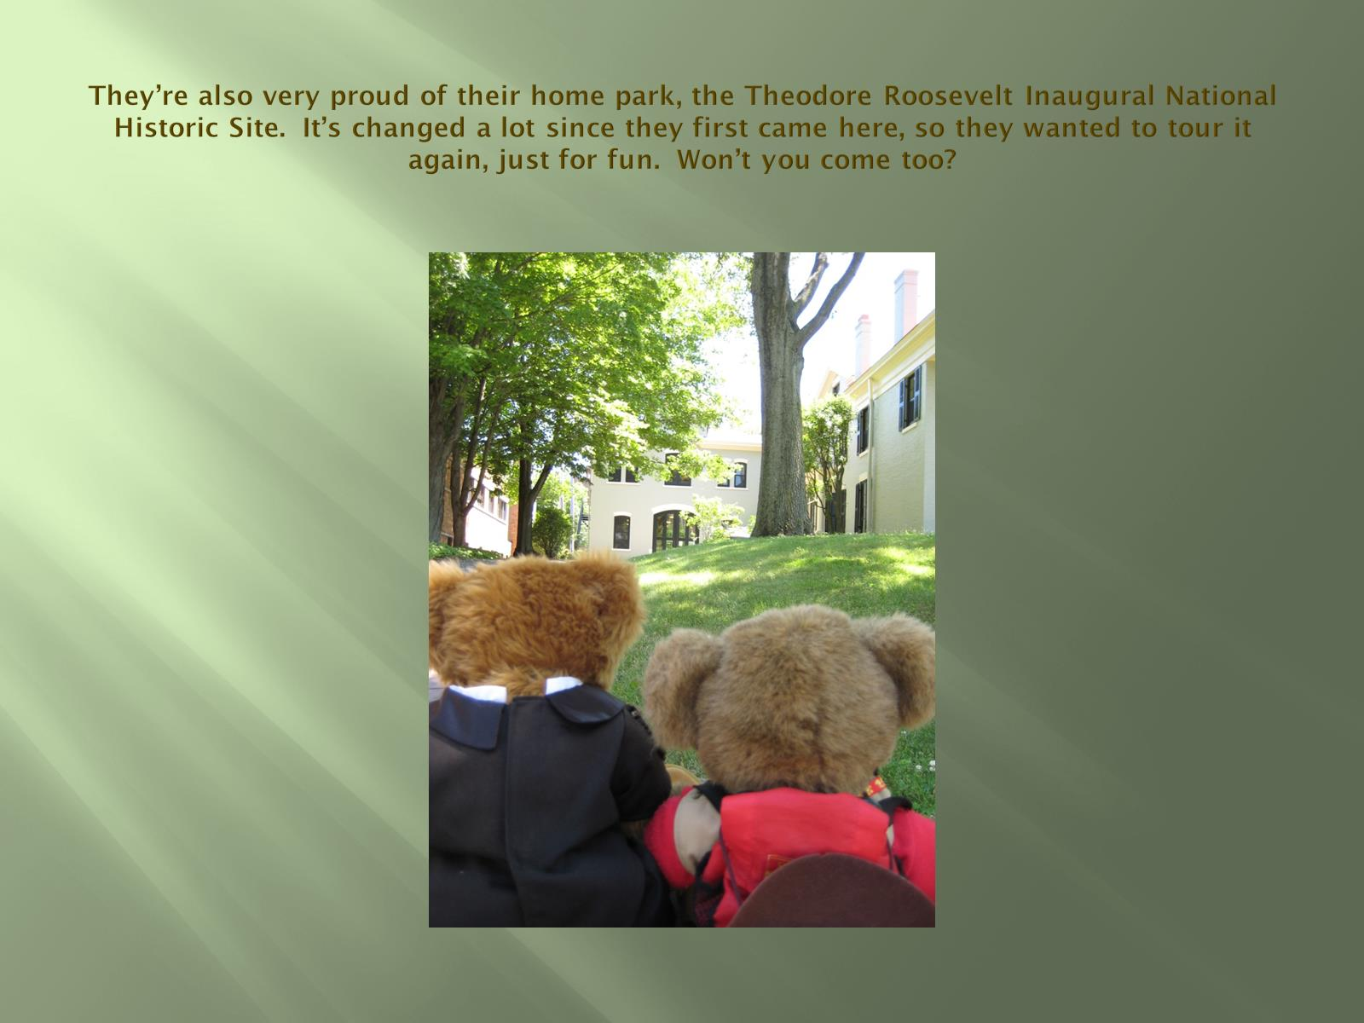
They’re also very proud of their home park, the Theodore Roosevelt Inaugural National Historic Site. It’s changed a lot since they first came here, so they wanted to tour it again, just for fun. Won’t you come too?

Slide 4
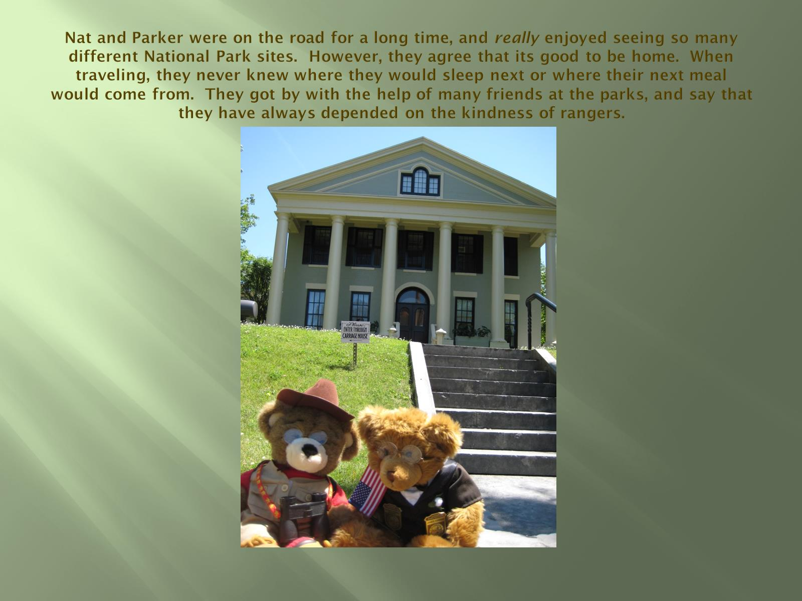
Nat and Parker were on the road for a long time, and really enjoyed seeing so many different National Park sites. However, they agree that its good to be home. When traveling, they never knew where they would sleep next or where their next meal would come from. They got by with the help of many friends at the parks, and say that they have always depended on the kindness of rangers.

Slide 5
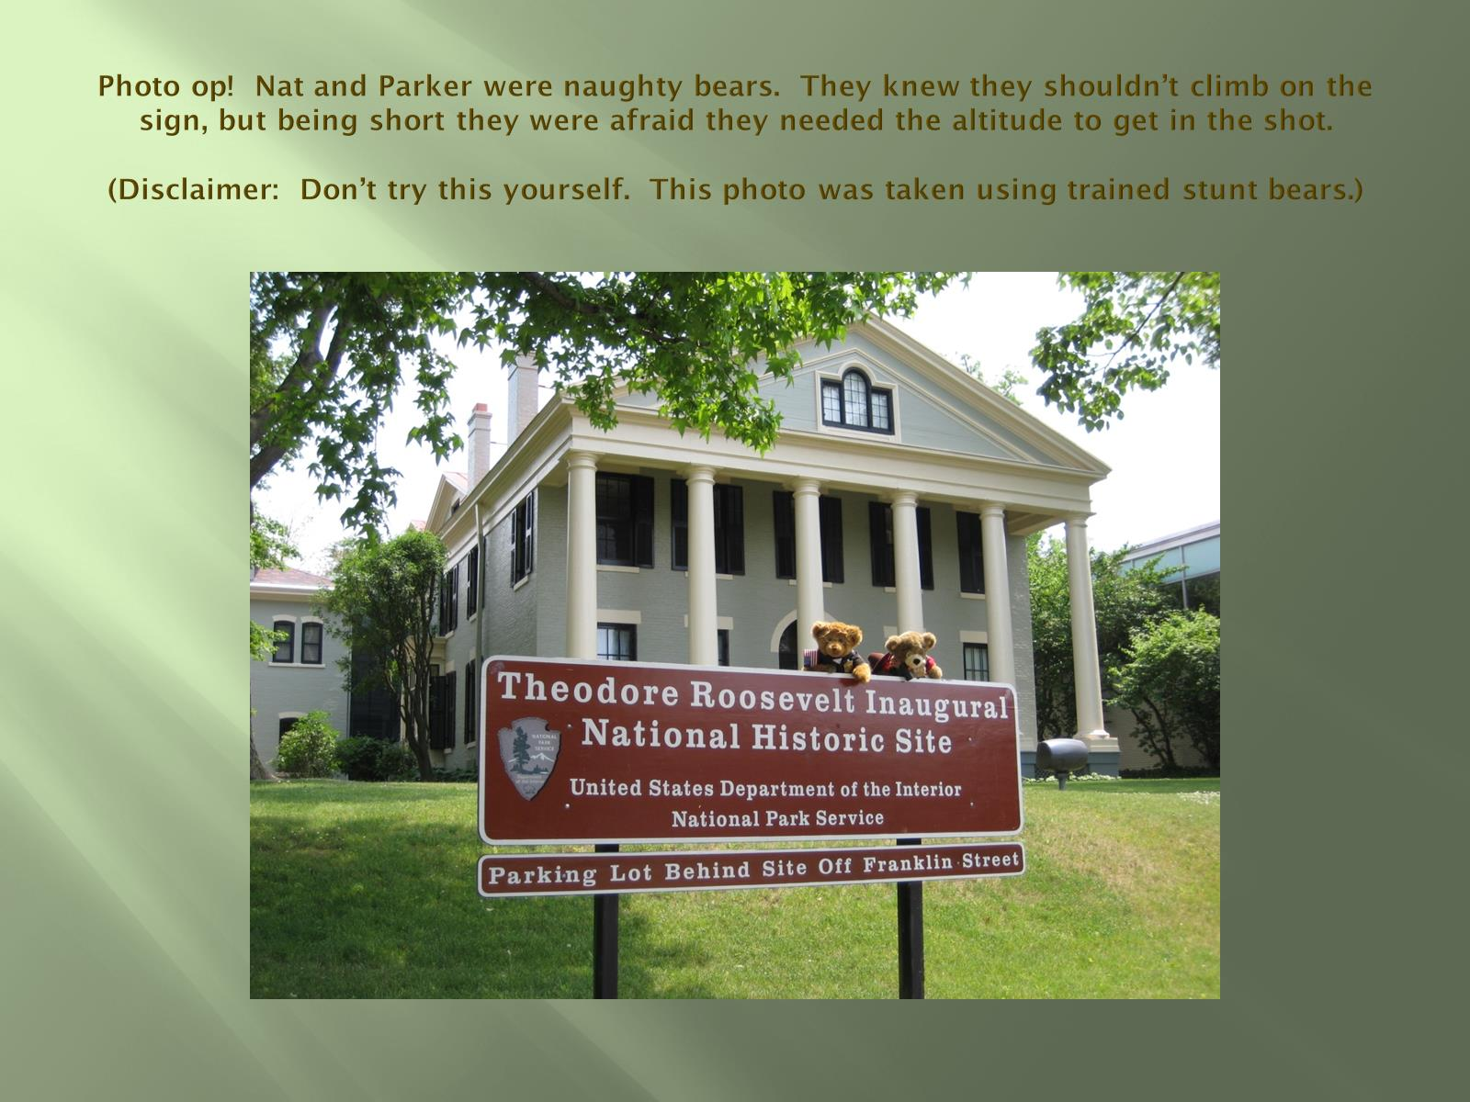
Photo op! Nat and Parker were naughty bears. They knew they shouldn’t climb on the sign, but being short they were afraid they needed the altitude to get in the shot.
(Disclaimer: Don’t try this yourself. This photo was taken using trained stunt bears.)

Slide 6
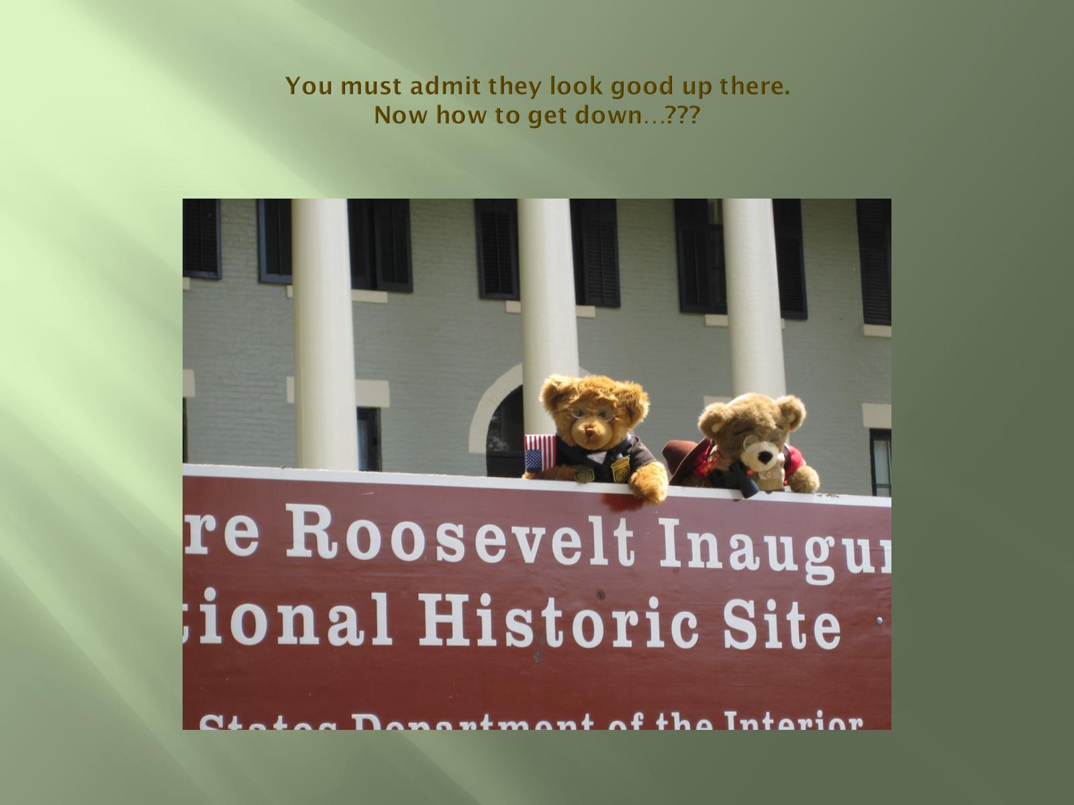
You must admit they look good up there.
Now how to get down…???

Slide 7
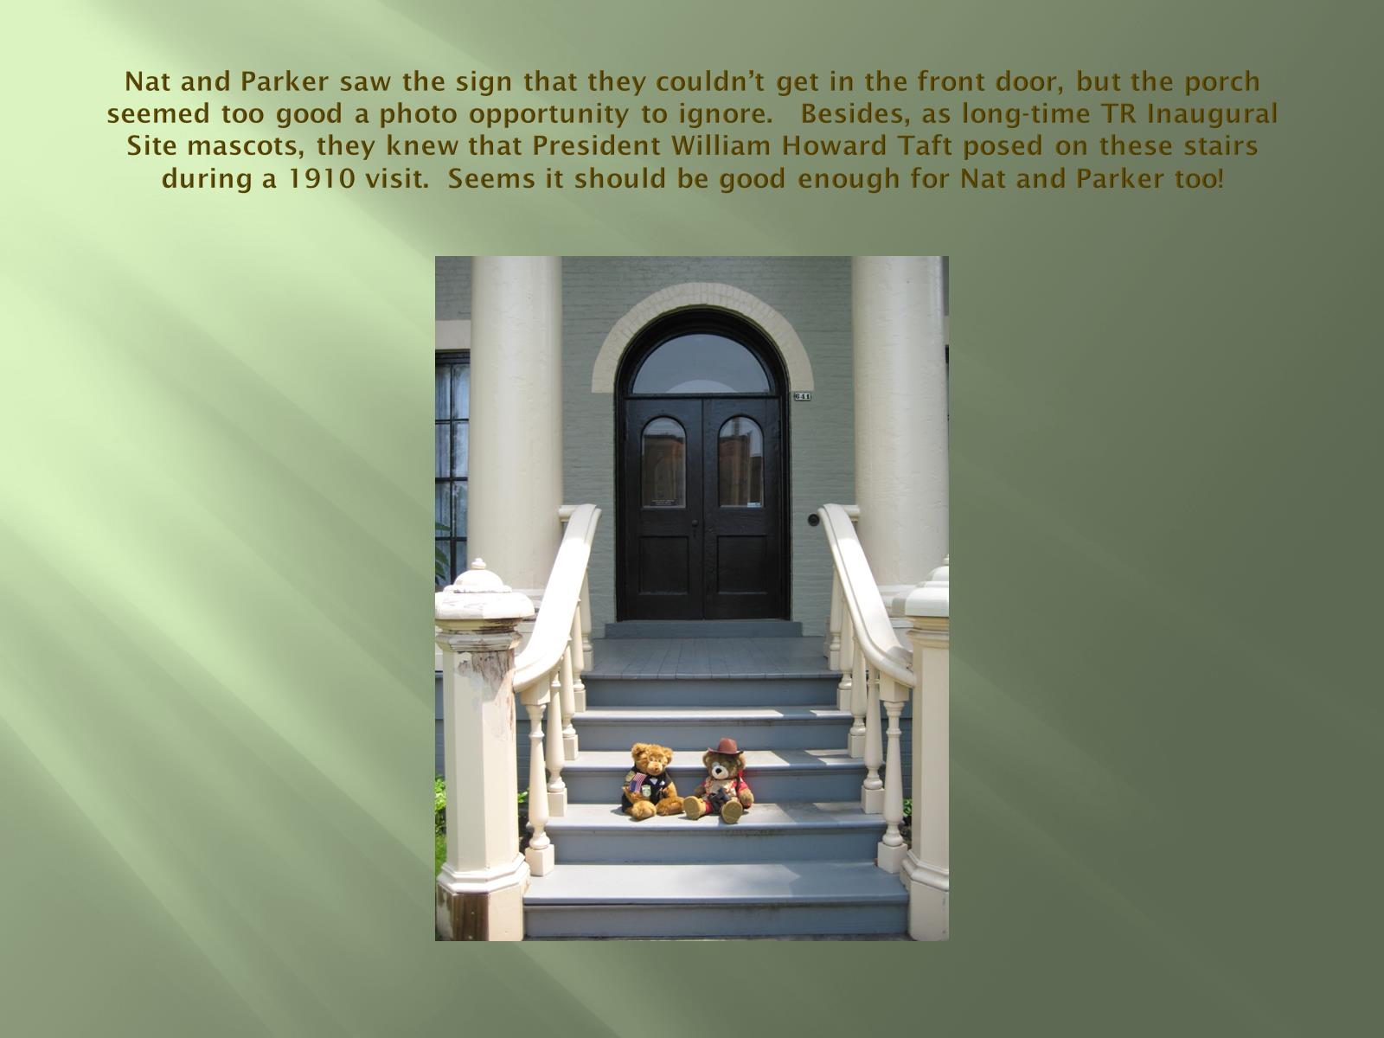
Nat and Parker saw the sign that they couldn’t get in the front door, but the porch seemed too good a photo opportunity to ignore. Besides, as long-time TR Inaugural Site mascots, they knew that President William Howard Taft posed on these stairs during a 1910 visit. Seems it should be good enough for Nat and Parker too!

Slide 8
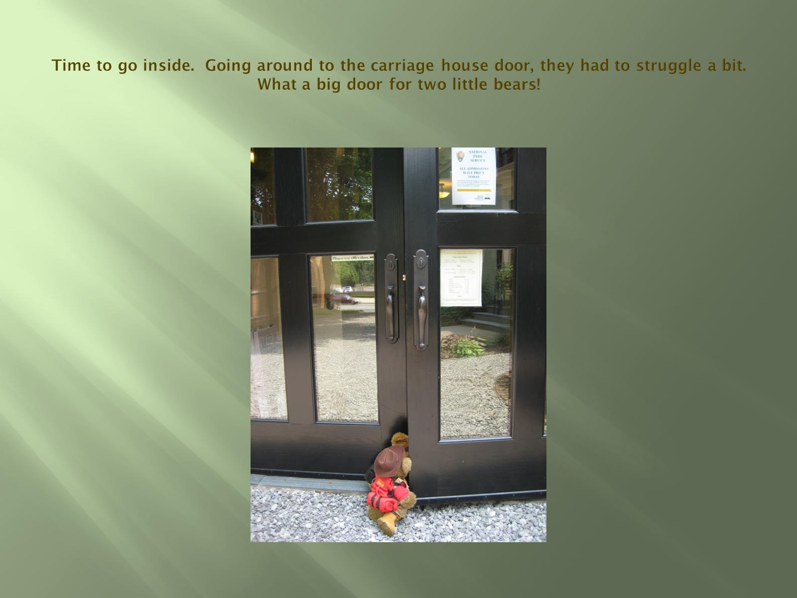
Time to go inside. Going around to the carriage house door, they had to struggle a bit. What a big door for two little bears!

Slide 9
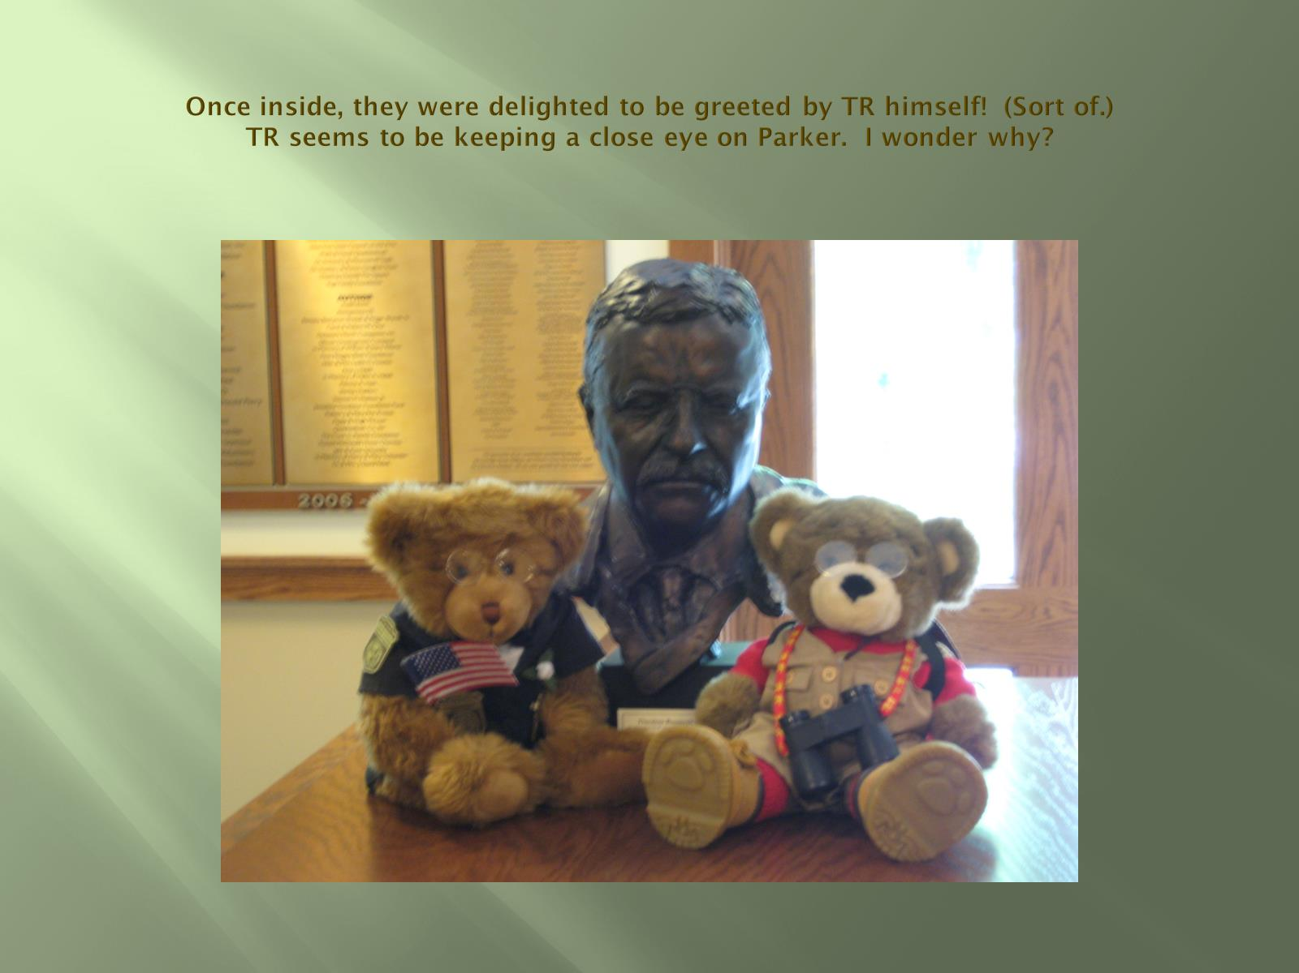
Once inside, they were delighted to be greeted by TR himself! (Sort of.)
TR seems to be keeping a close eye on Parker. I wonder why?

Slide 10
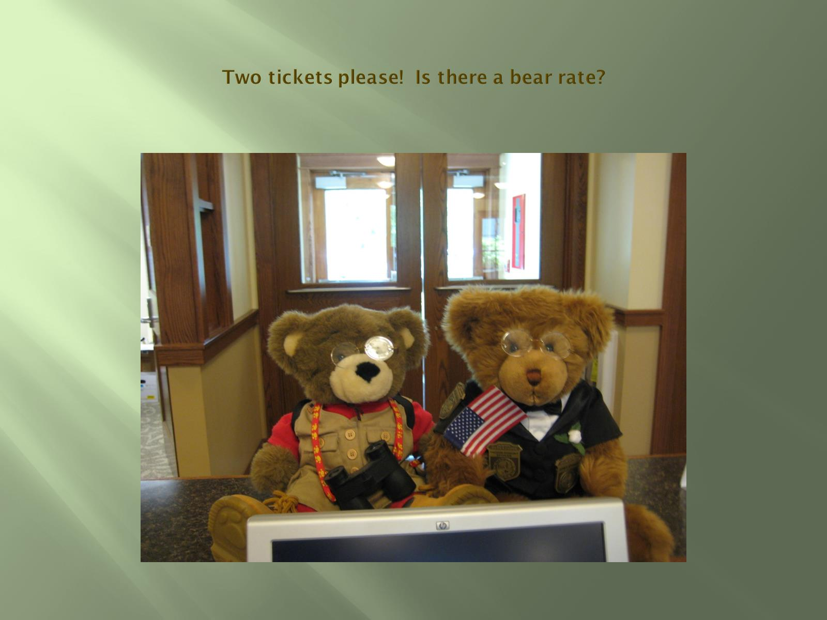
Two tickets please! Is there a bear rate?

Slide 11
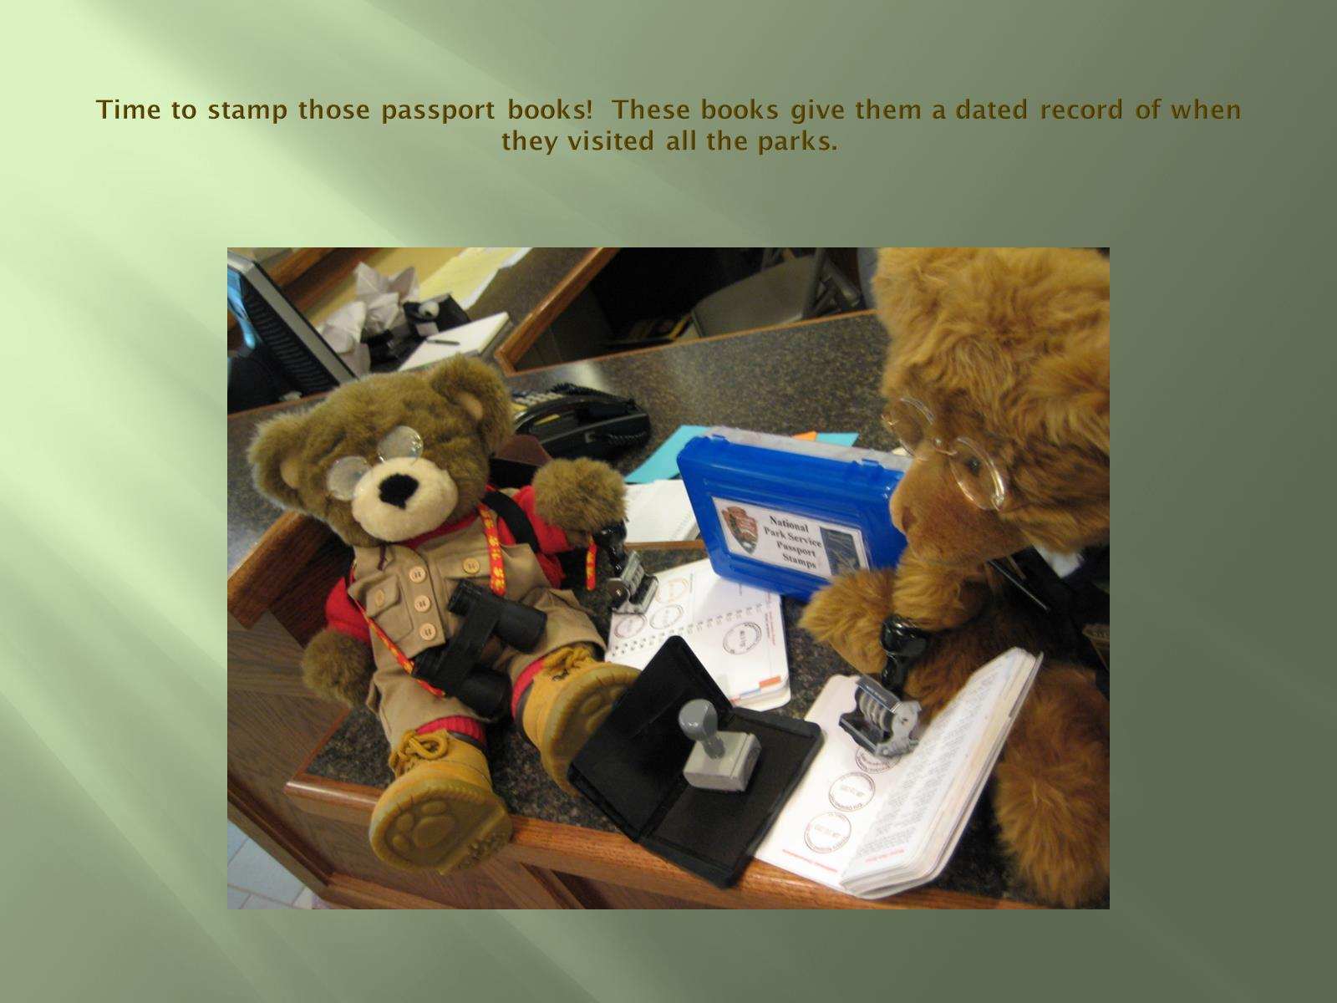
Time to stamp those passport books! These books give them a dated record of when they visited all the parks.

Slide 12
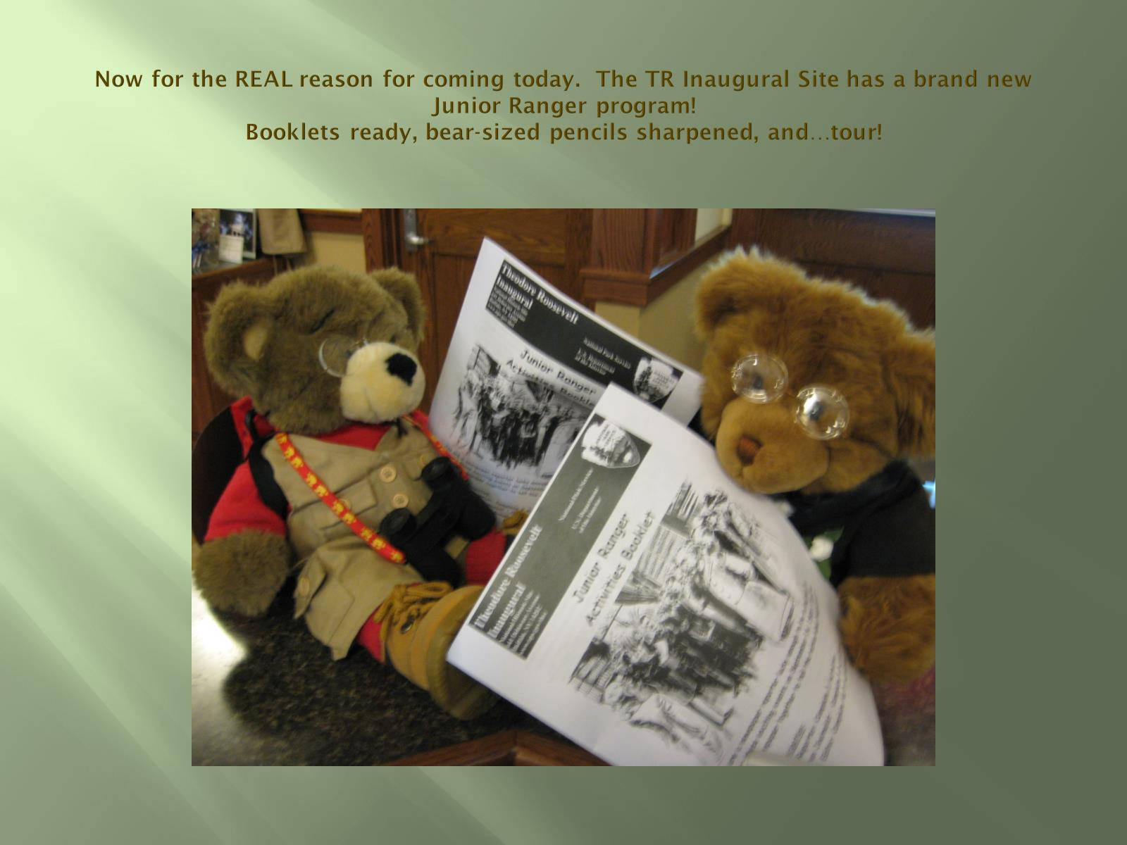
Now for the REAL reason for coming today. The TR Inaugural Site has a brand new Junior Ranger program!
Booklets ready, bear-sized pencils sharpened, and…tour!

Slide 13
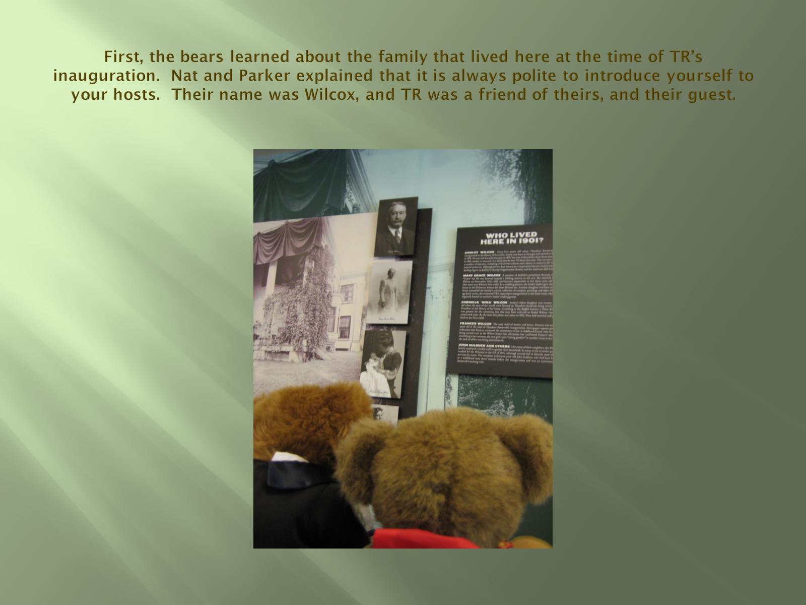
First, the bears learned about the family that lived here at the time of TR’s inauguration. Nat and Parker explained that it is always polite to introduce yourself to your hosts. Their name was Wilcox, and TR was a friend of theirs, and their guest.

Slide 14
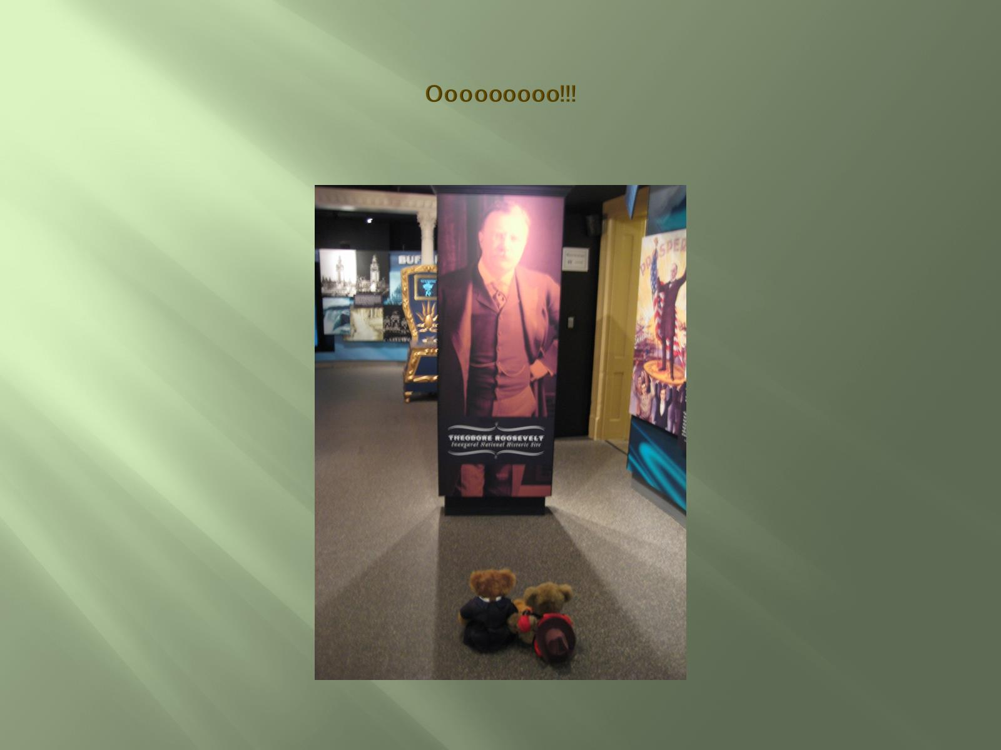
Ooooooooo!!!

Slide 15
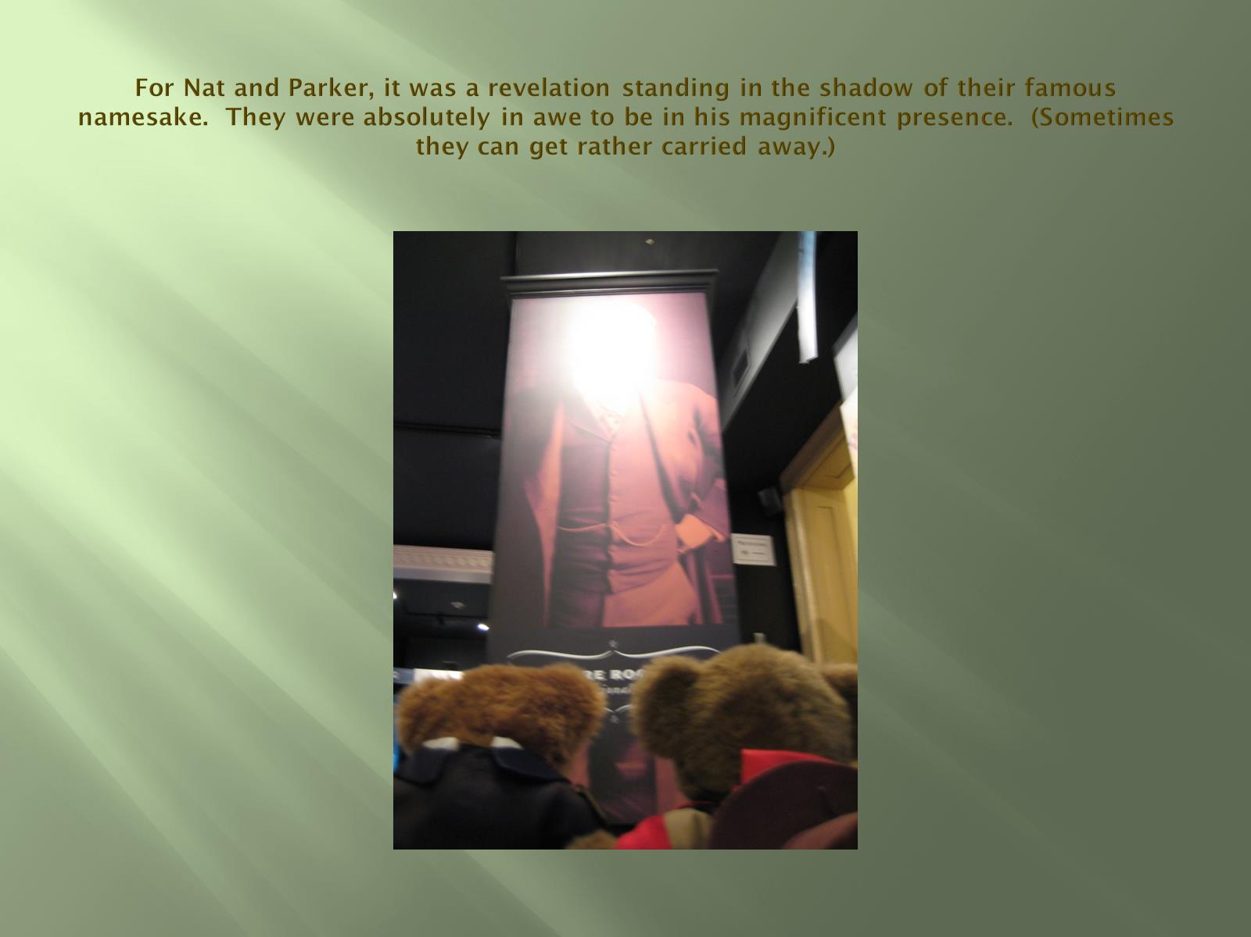
For Nat and Parker, it was a revelation standing in the shadow of their famous namesake. They were absolutely in awe to be in his magnificent presence. (Sometimes they can get rather carried away.)

Slide 16
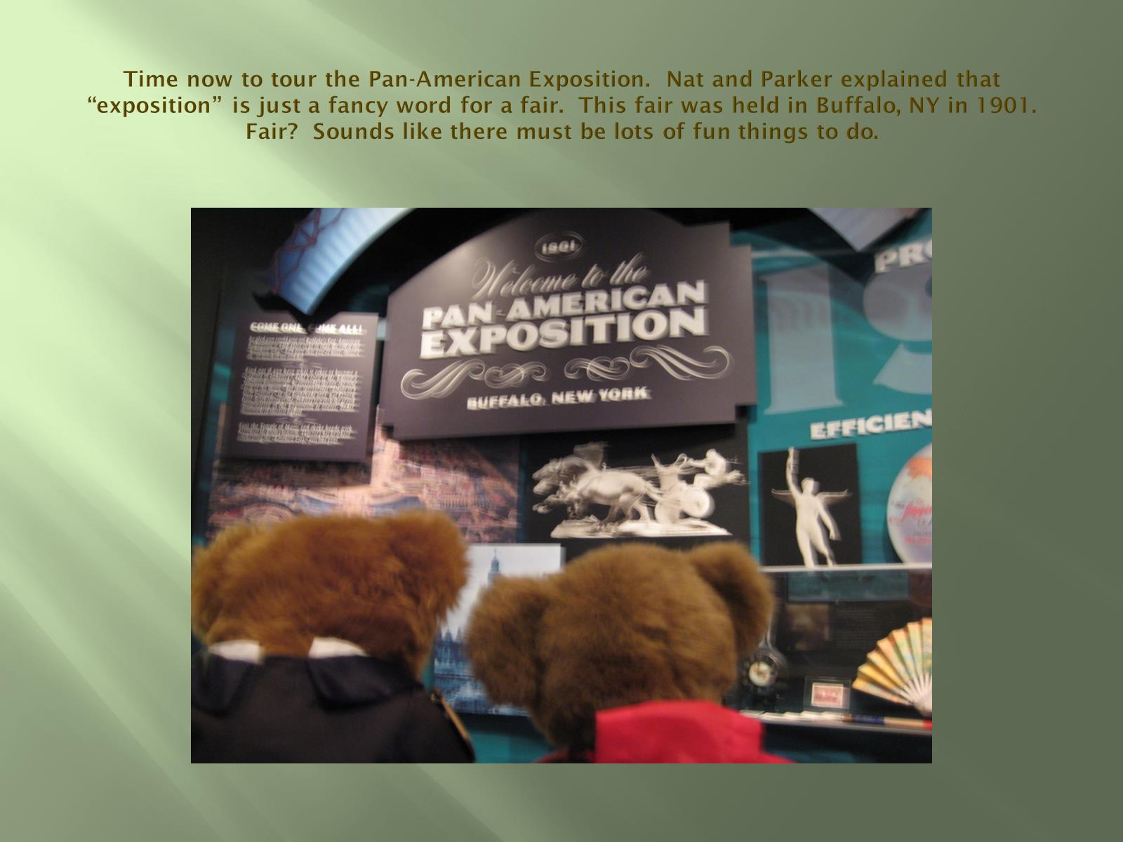
Time now to tour the Pan-American Exposition. Nat and Parker explained that “exposition” is just a fancy word for a fair. This fair was held in Buffalo, NY in 1901. Fair? Sounds like there must be lots of fun things to do.

Slide 17
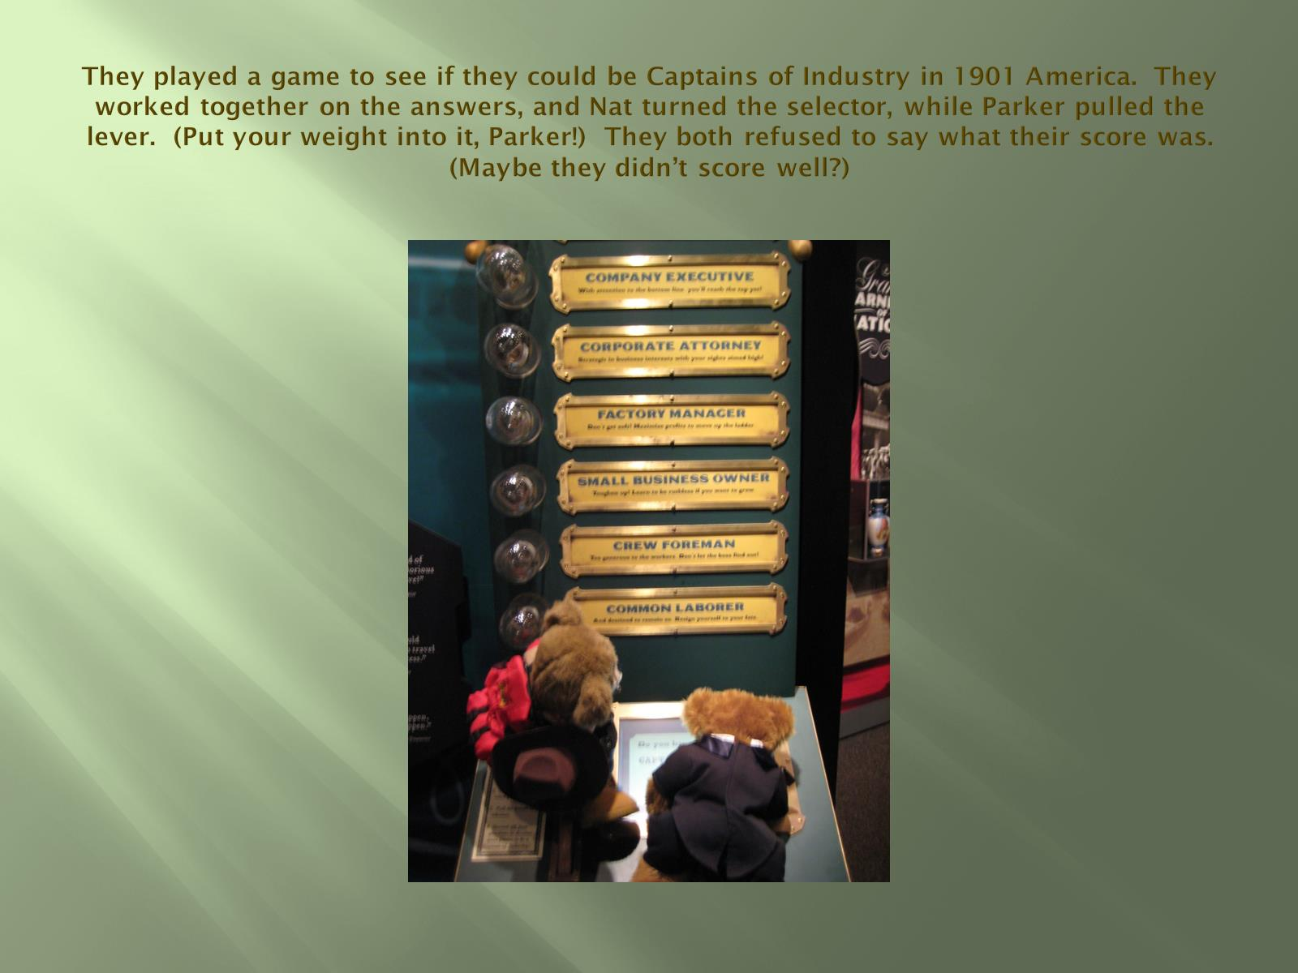
They played a game to see if they could be Captains of Industry in 1901 America. They worked together on the answers, and Nat turned the selector, while Parker pulled the lever. (Put your weight into it, Parker!) They both refused to say what their score was. (Maybe they didn’t score well?)

Slide 18
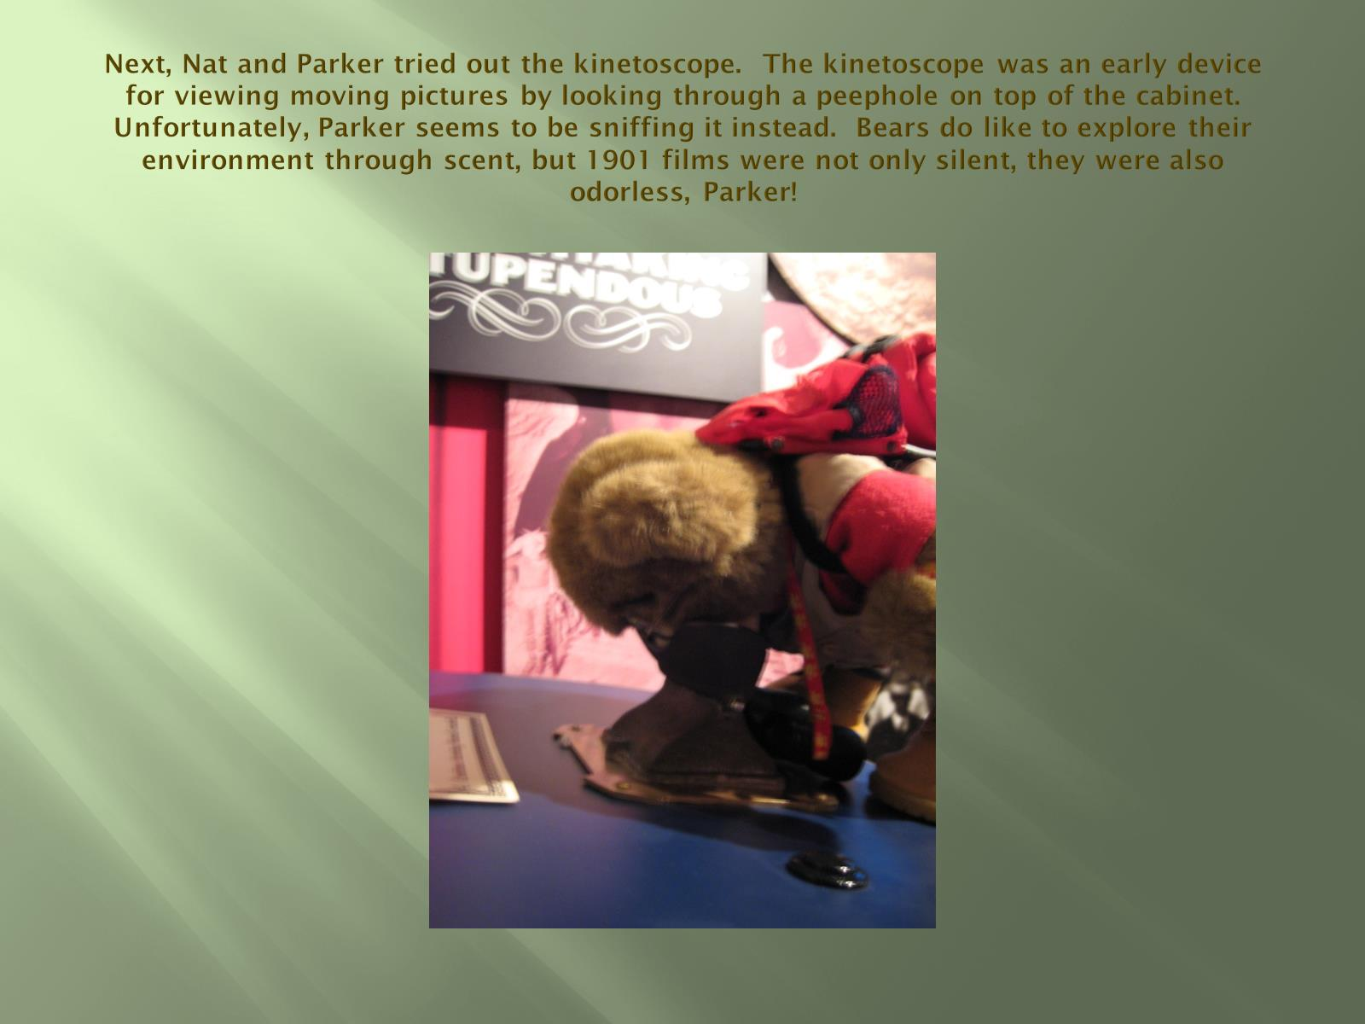
Next, Nat and Parker tried out the kinetoscope. The kinetoscope was an early device for viewing moving pictures by looking through a peephole on top of the cabinet. Unfortunately, Parker seems to be sniffing it instead. Bears do like to explore their environment through scent, but 1901 films were not only silent, they were also odorless, Parker!

Slide 19
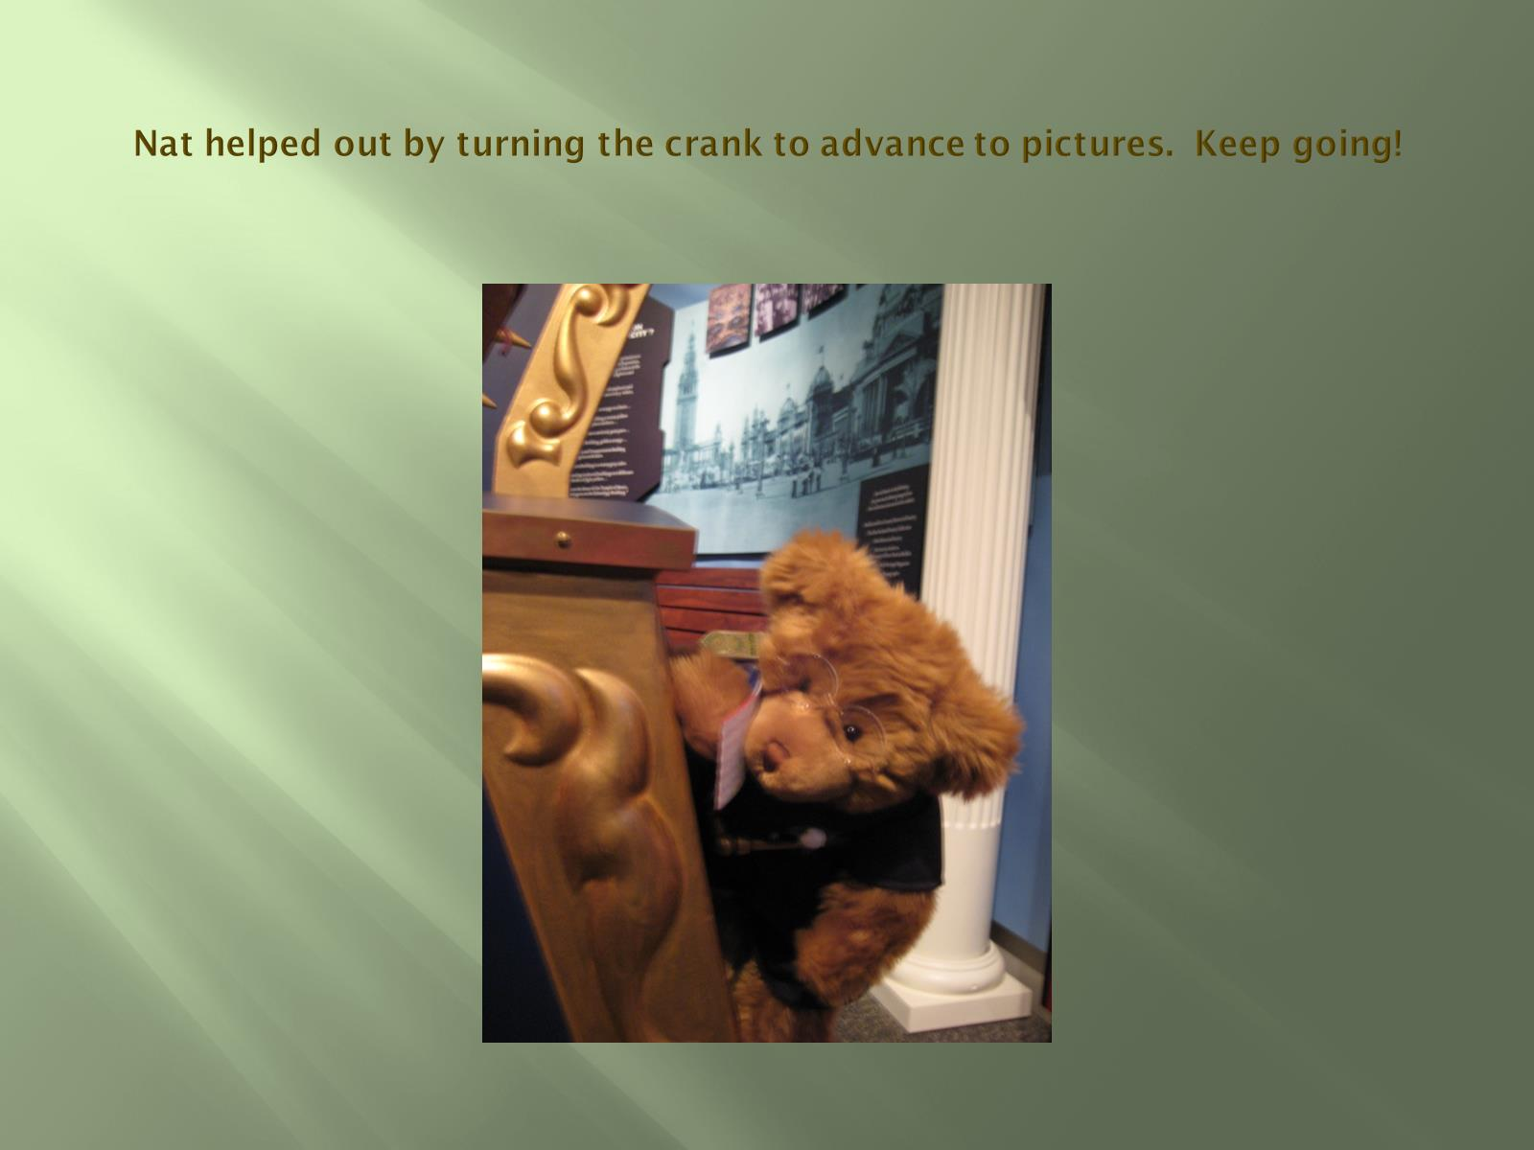
Nat helped out by turning the crank to advance to pictures. Keep going!

Slide 20
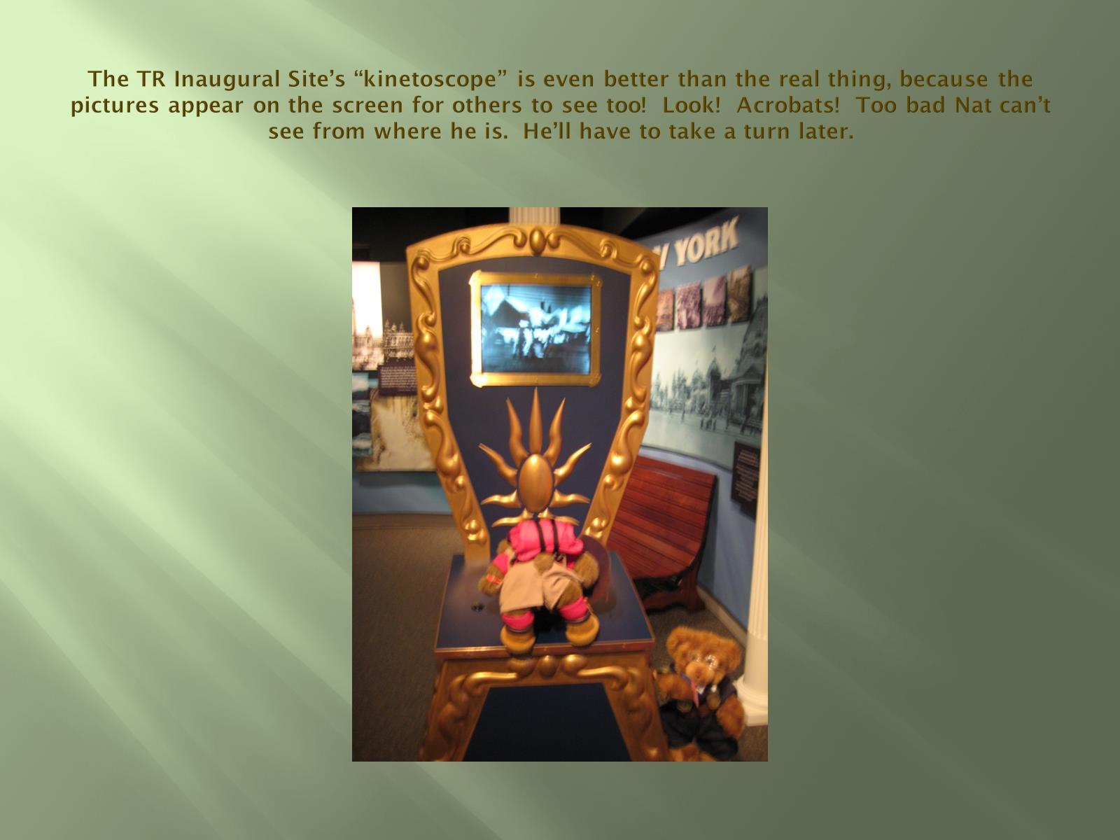
The TR Inaugural Site’s “kinetoscope” is even better than the real thing, because the pictures appear on the screen for others to see too! Look! Acrobats! Too bad Nat can’t see from where he is. He’ll have to take a turn later.

Slide 21
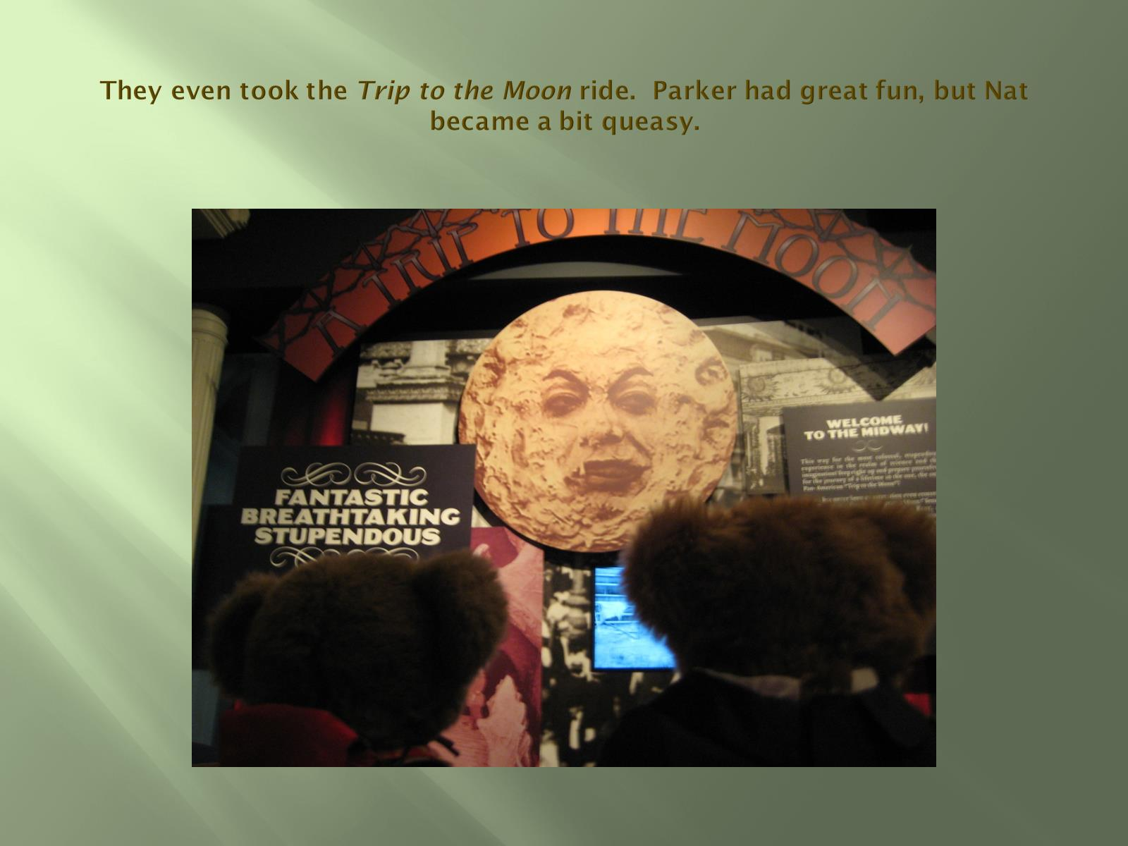
They even took the Trip to the Moon ride. Parker had great fun, but Nat became a bit queasy.

Slide 22
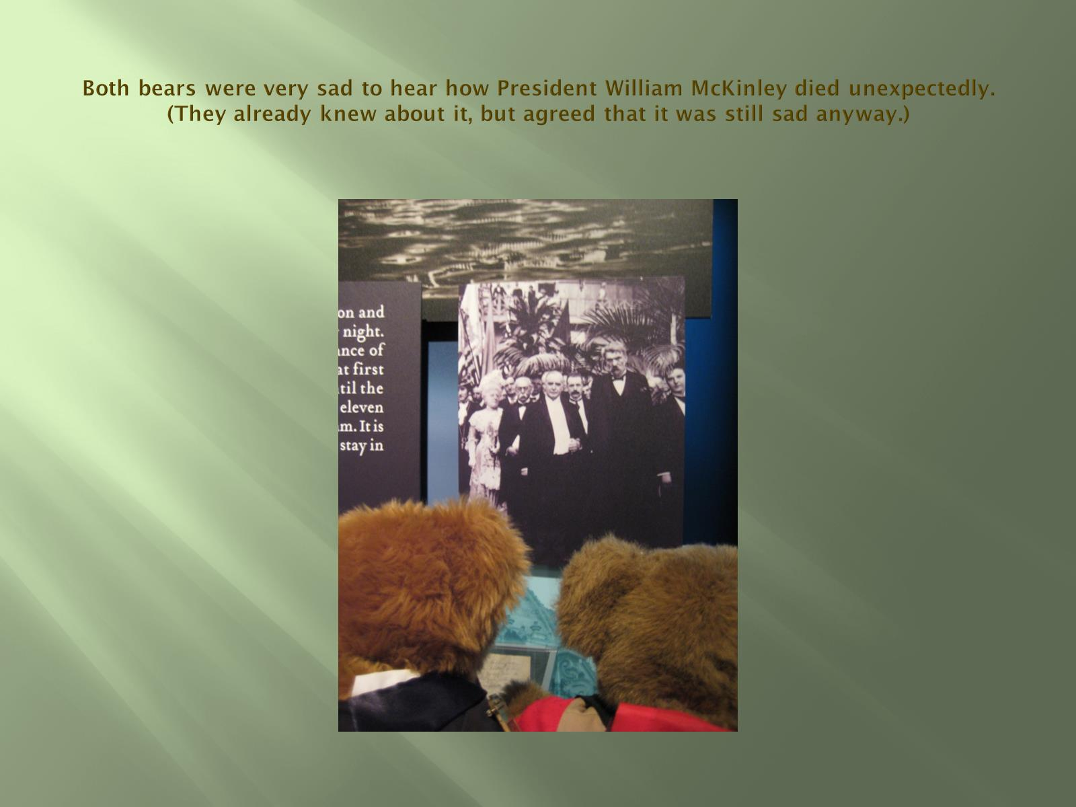
Both bears were very sad to hear how President William McKinley died unexpectedly.
(They already knew about it, but agreed that it was still sad anyway.)

Slide 23
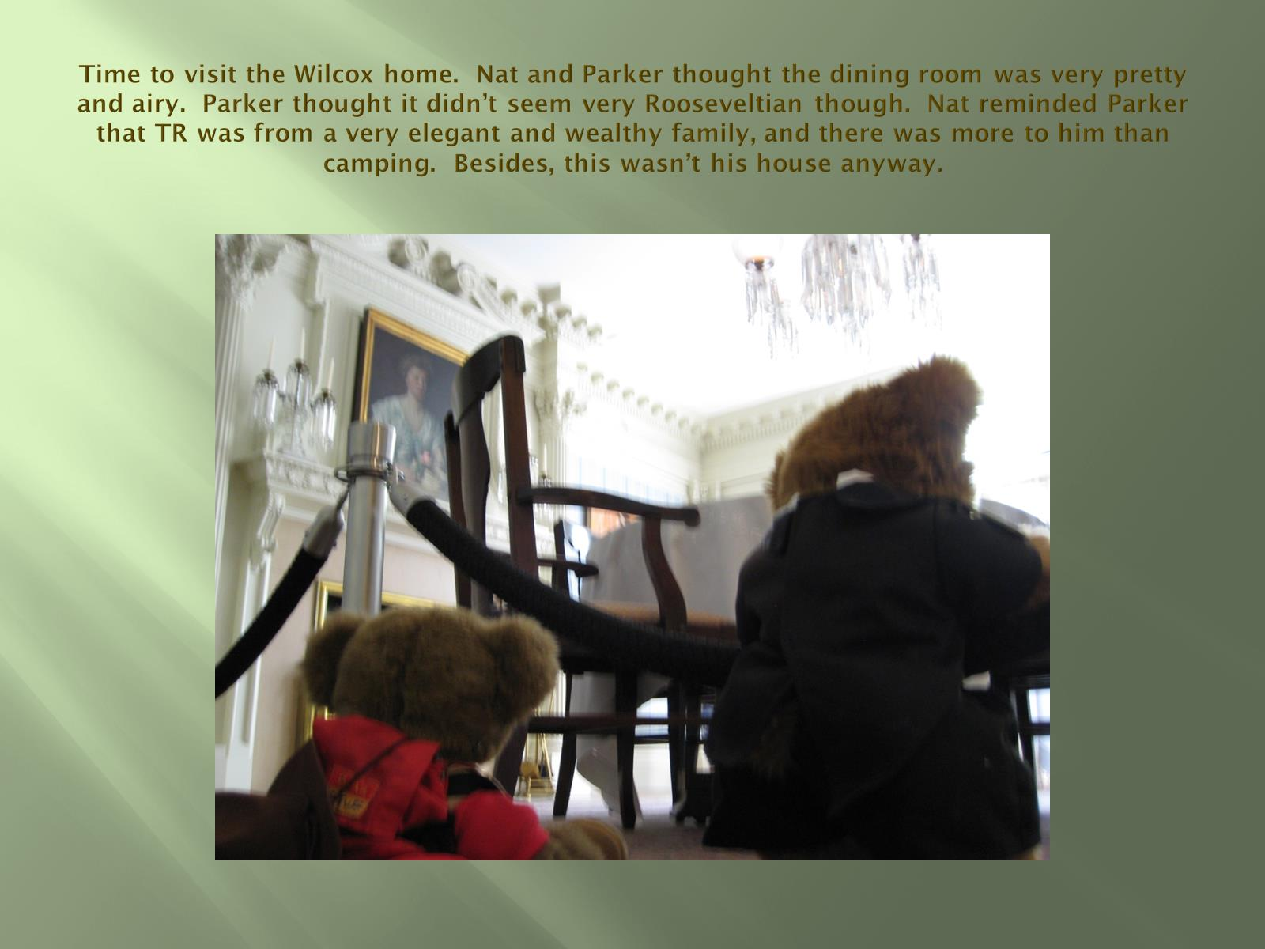
Time to visit the Wilcox home. Nat and Parker thought the dining room was very pretty and airy. Parker thought it didn’t seem very Rooseveltian though. Nat reminded Parker that TR was from a very elegant and wealthy family, and there was more to him than camping. Besides, this wasn’t his house anyway.

Slide 24
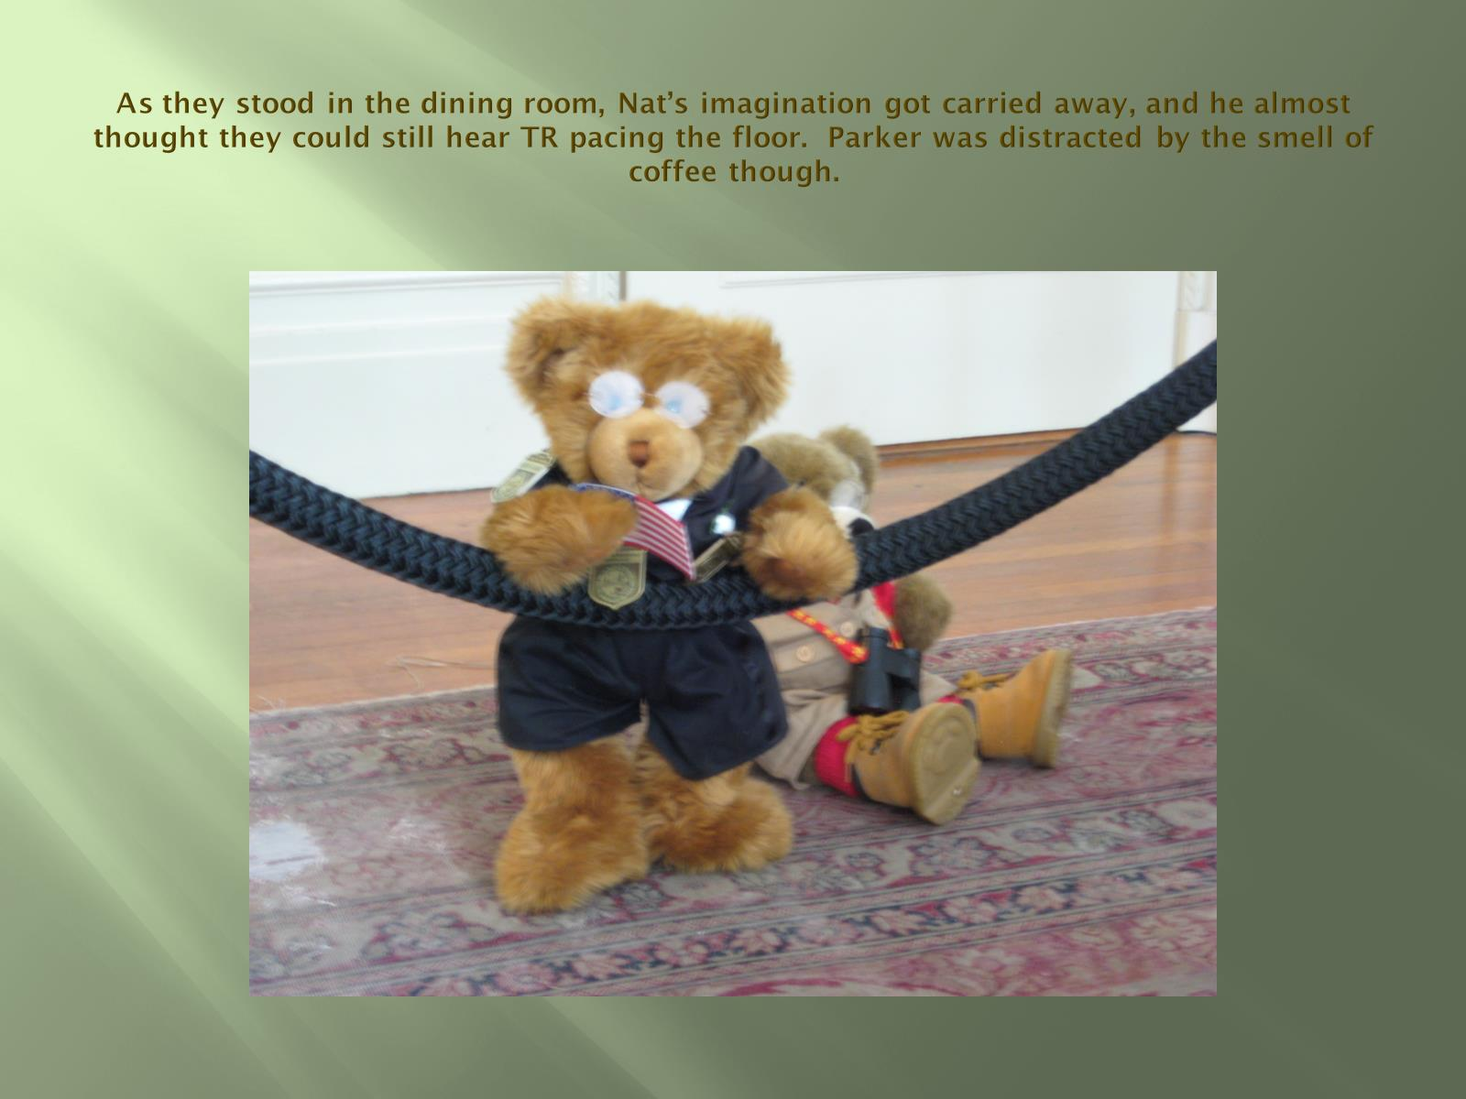
As they stood in the dining room, Nat’s imagination got carried away, and he almost thought they could still hear TR pacing the floor. Parker was distracted by the smell of coffee though.

Slide 25
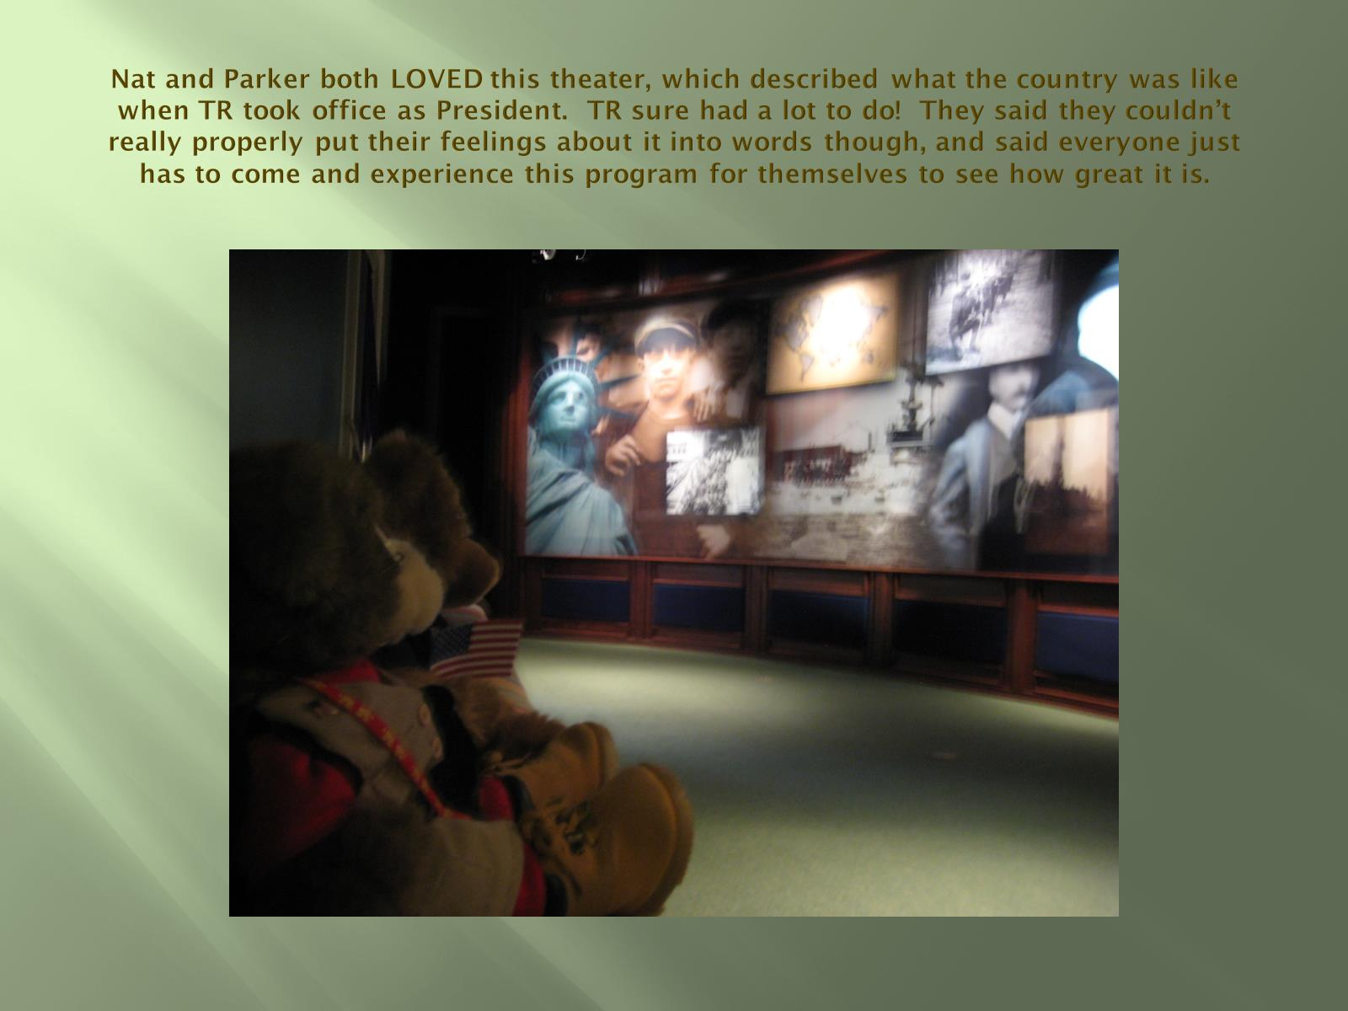
Nat and Parker both LOVED this theater, which described what the country was like when TR took office as President. TR sure had a lot to do! They said they couldn’t really properly put their feelings about it into words though, and said everyone just has to come and experience this program for themselves to see how great it is.

Slide 26
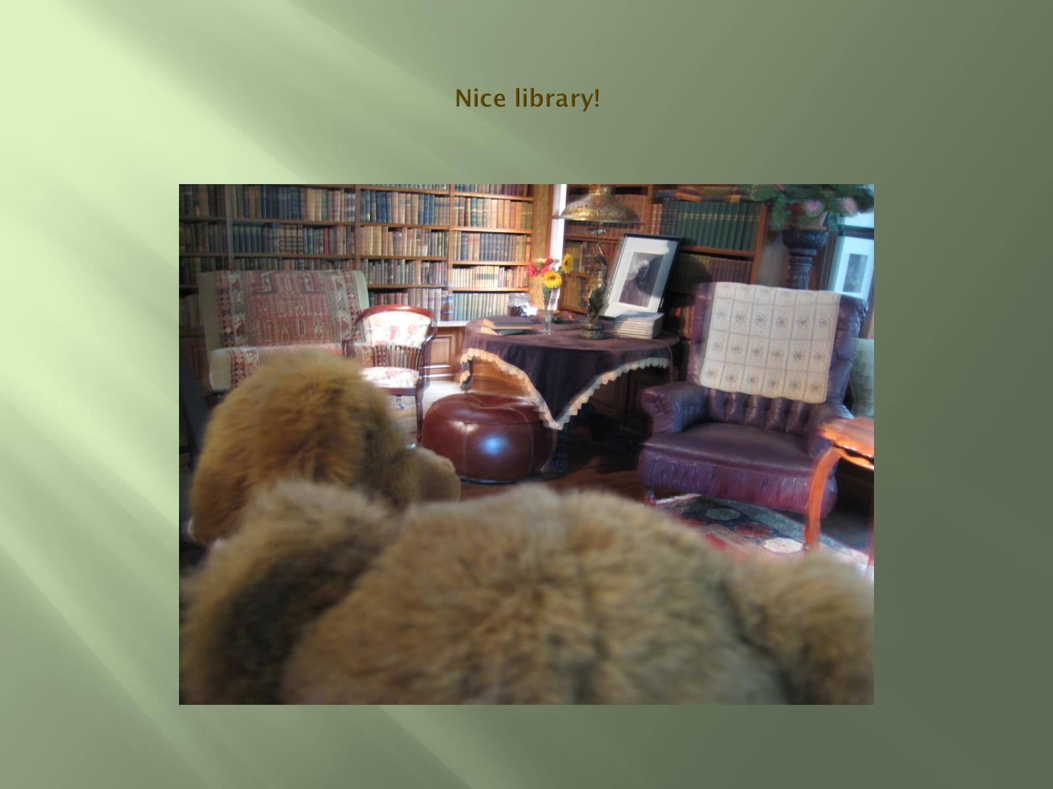
Nice library!

Slide 27
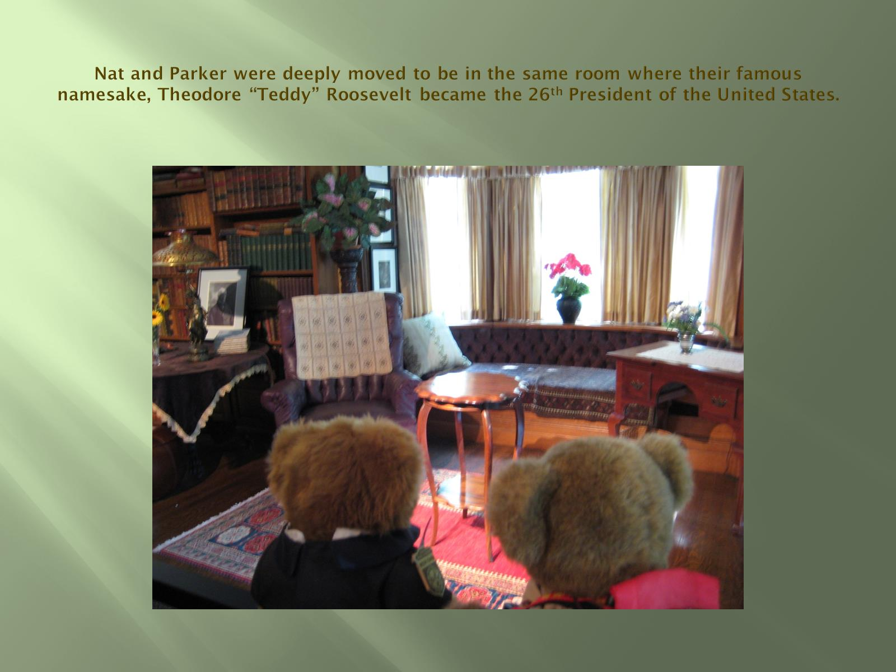
Nat and Parker were deeply moved to be in the same room where their famous namesake, Theodore “Teddy” Roosevelt became the 26th President of the United States.

Slide 28
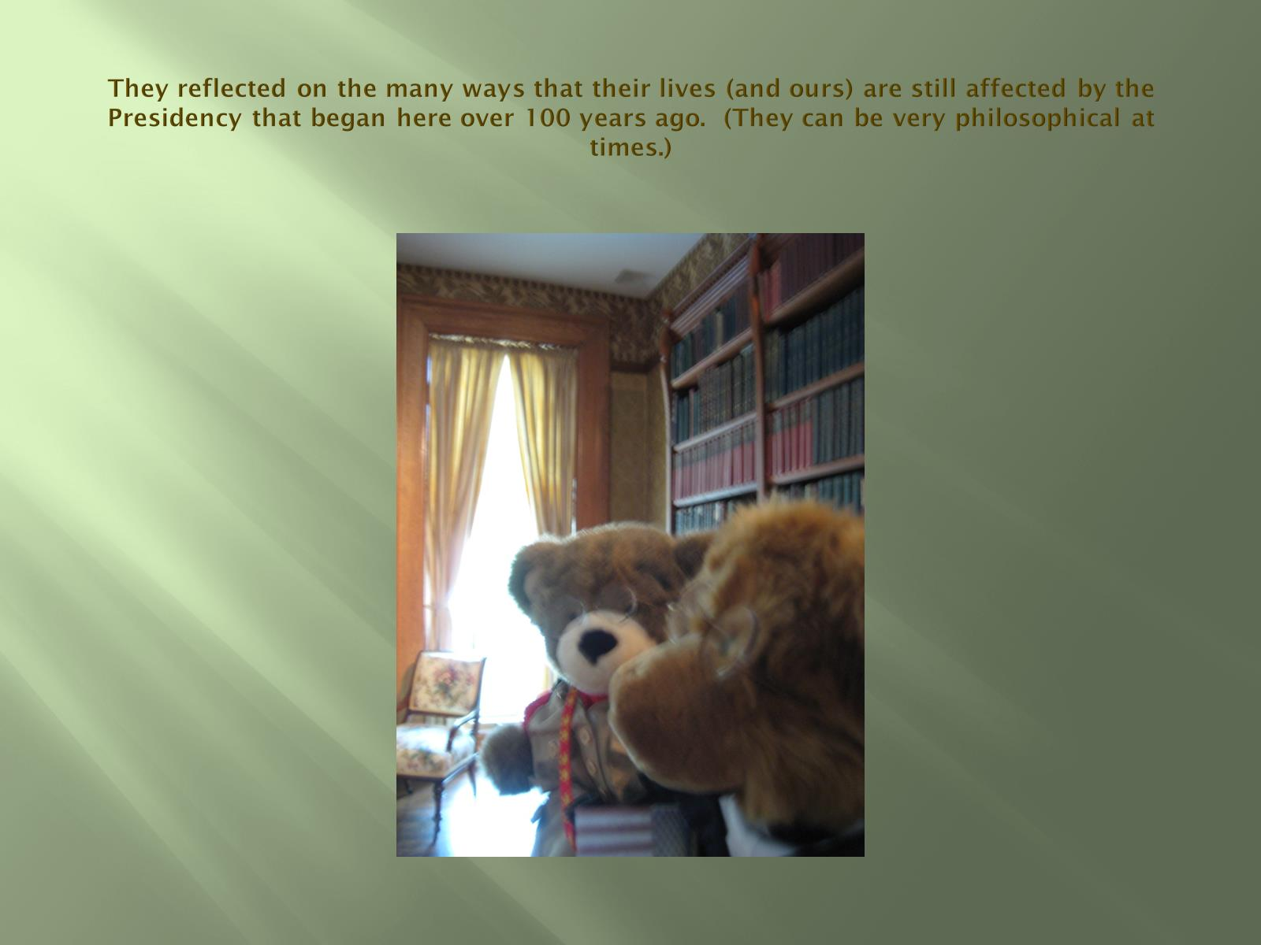
They reflected on the many ways that their lives (and ours) are still affected by the Presidency that began here over 100 years ago. (They can be very philosophical at times.)

Slide 29
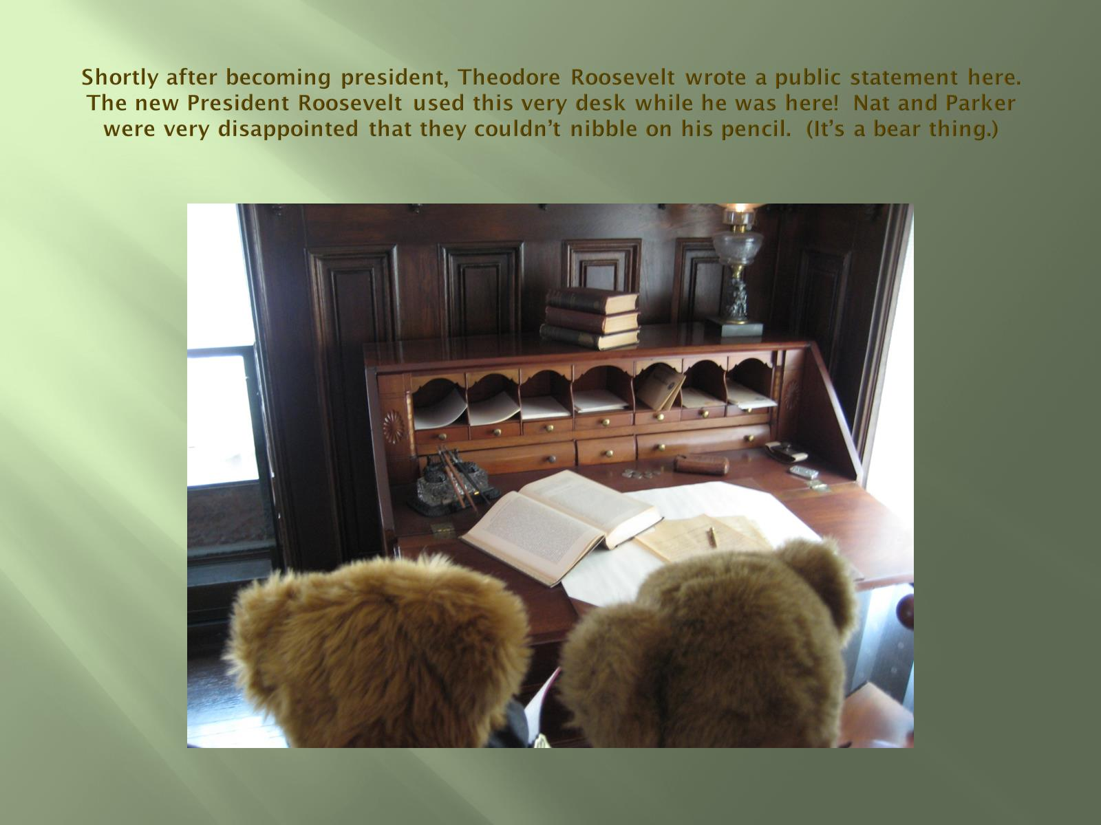
Shortly after becoming president, Theodore Roosevelt wrote a public statement here. The new President Roosevelt used this very desk while he was here! Nat and Parker were very disappointed that they couldn’t nibble on his pencil. (It’s a bear thing.)

Slide 30
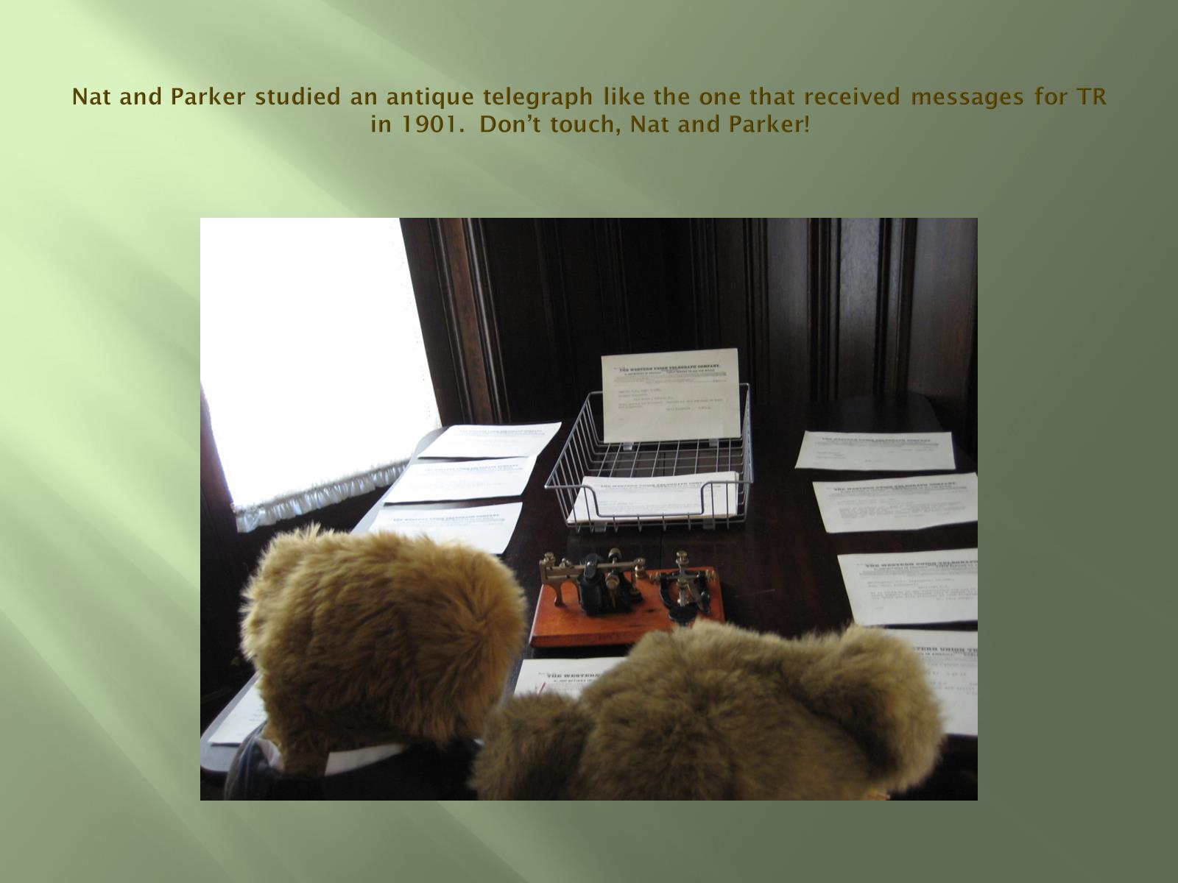
Nat and Parker studied an antique telegraph like the one that received messages for TR in 1901. Don’t touch, Nat and Parker!

Slide 31
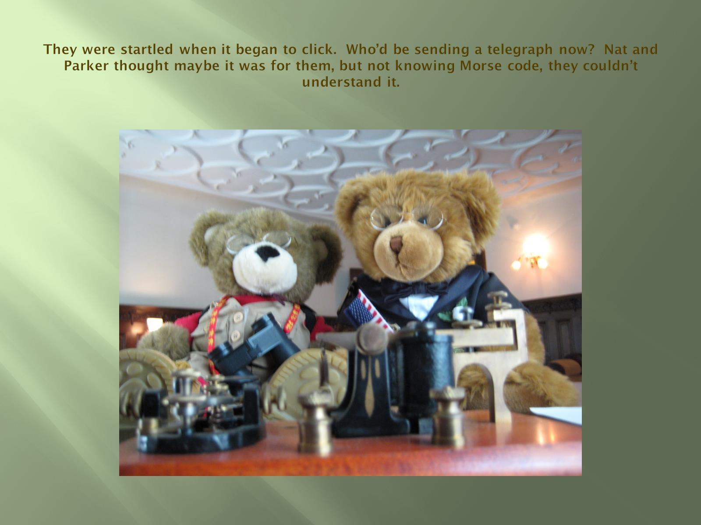
They were startled when it began to click. Who’d be sending a telegraph now? Nat and Parker thought maybe it was for them, but not knowing Morse code, they couldn’t understand it.

Slide 32
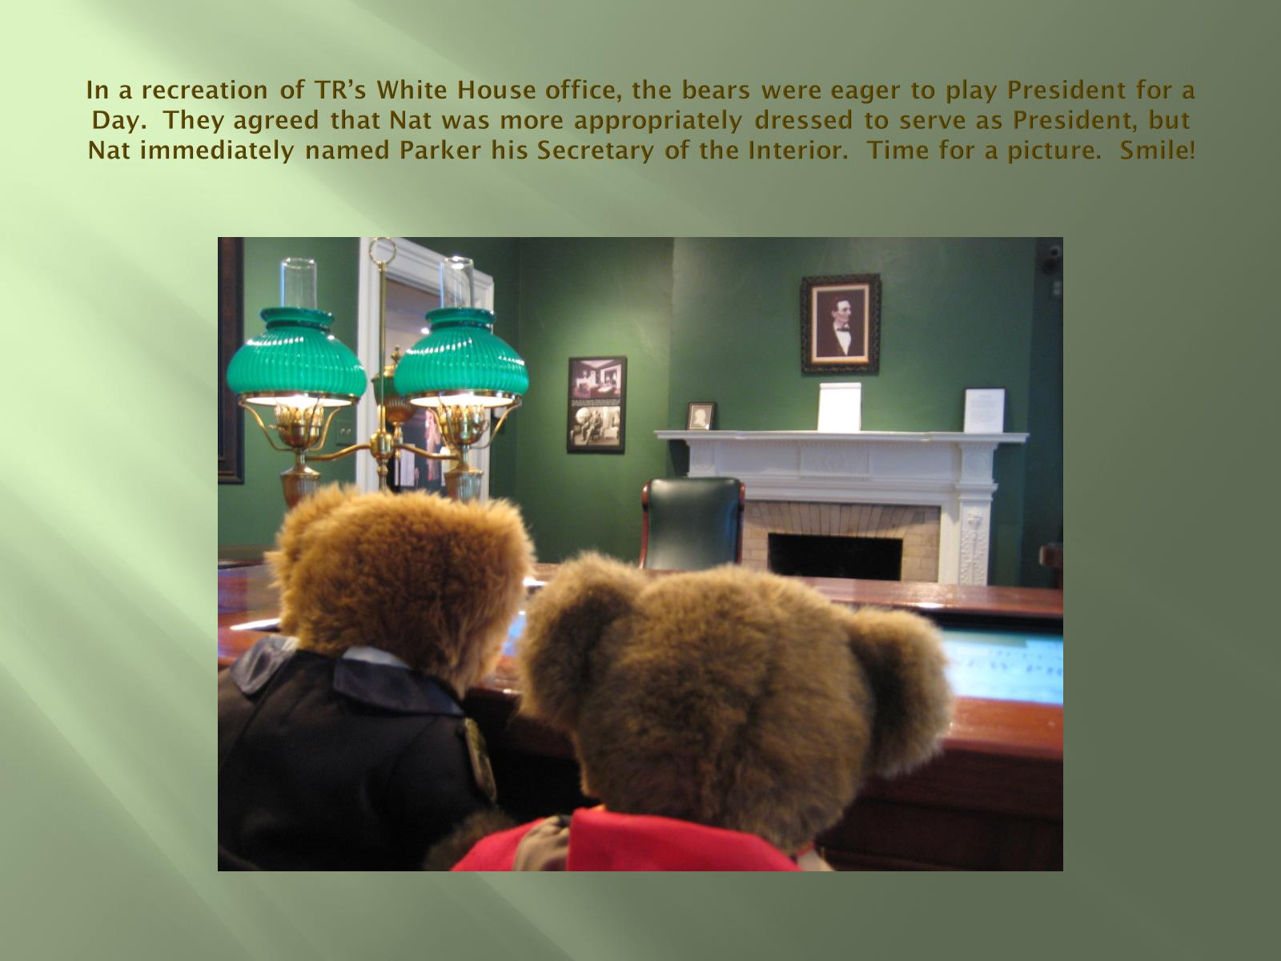
In a recreation of TR’s White House office, the bears were eager to play President for a Day. They agreed that Nat was more appropriately dressed to serve as President, but Nat immediately named Parker his Secretary of the Interior. Time for a picture. Smile!

Slide 33
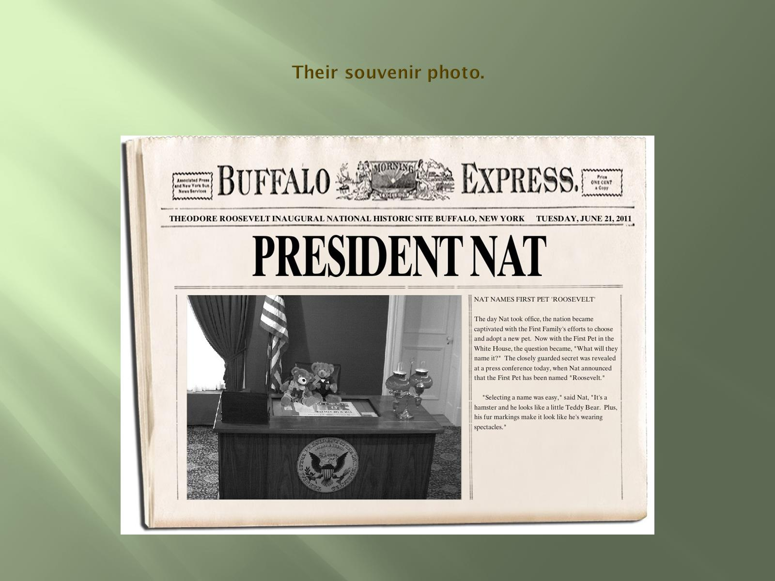
Their souvenir photo.

Slide 34
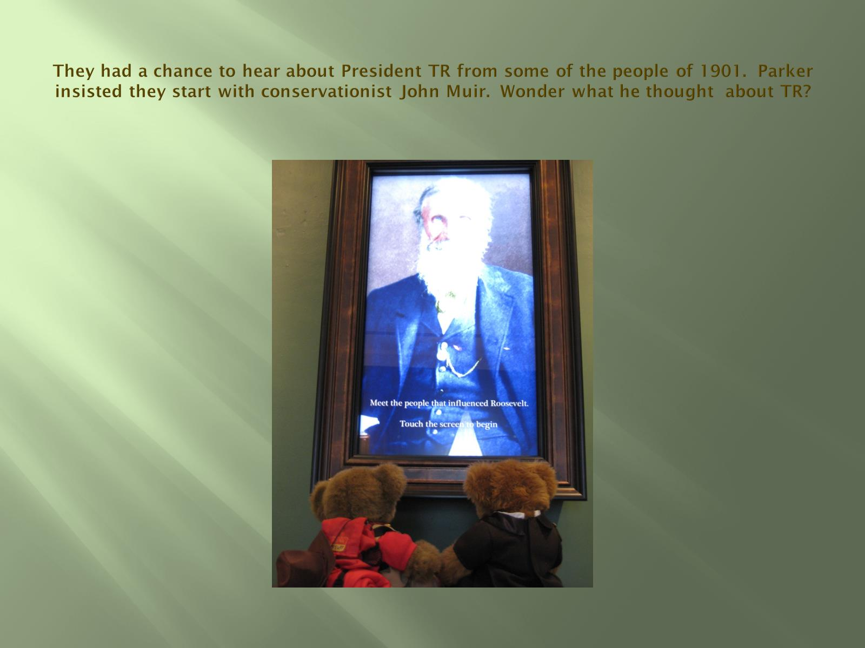
They had a chance to hear about President TR from some of the people of 1901. Parker insisted they start with conservationist John Muir. Wonder what he thought about TR?

Slide 35
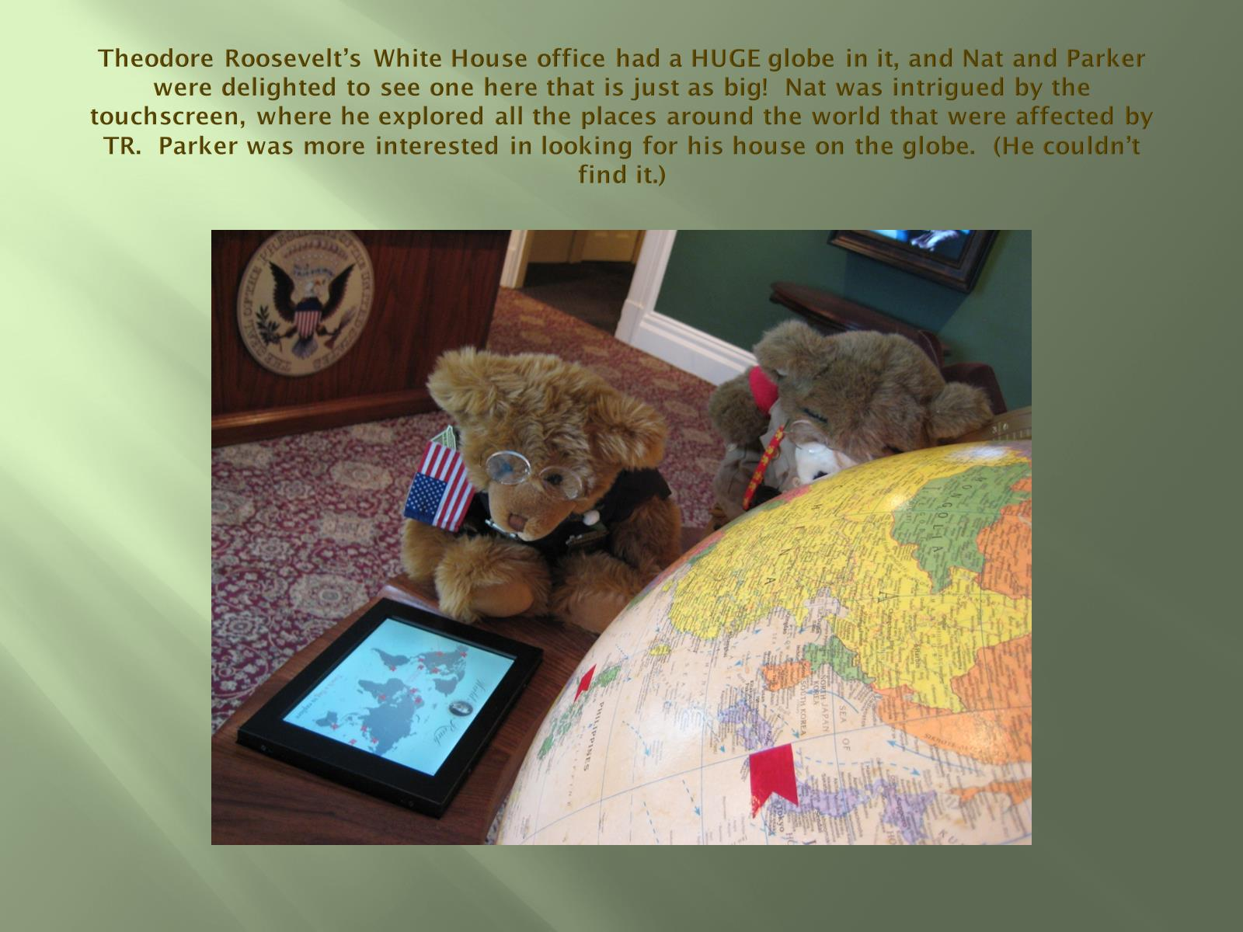
Theodore Roosevelt’s White House office had a HUGE globe in it, and Nat and Parker were delighted to see one here that is just as big! Nat was intrigued by the touchscreen, where he explored all the places around the world that were affected by TR. Parker was more interested in looking for his house on the globe. (He couldn’t find it.)

Slide 36
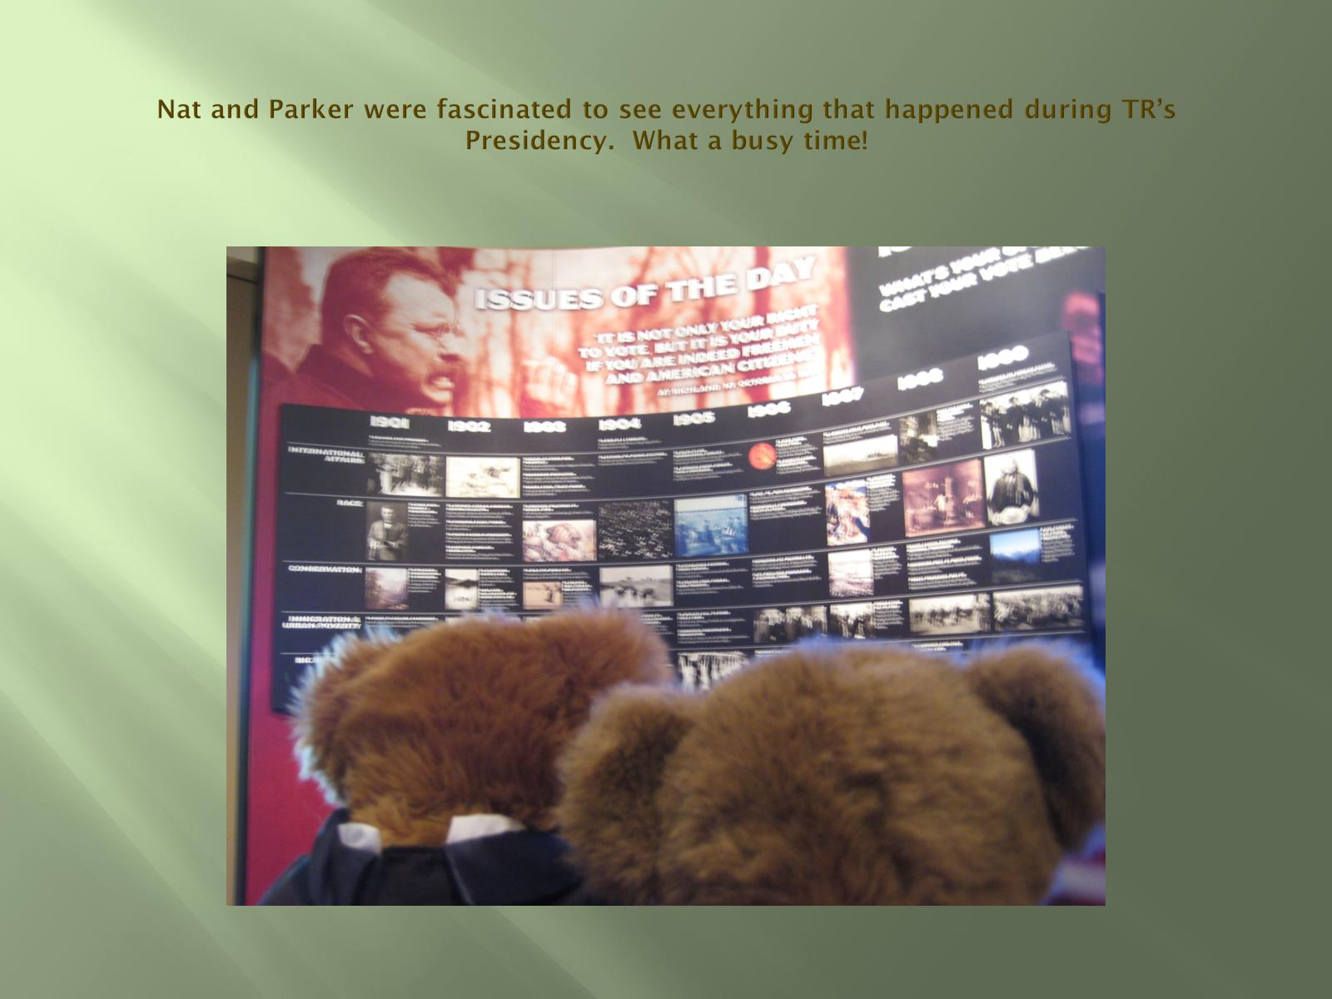
Nat and Parker were fascinated to see everything that happened during TR’s Presidency. What a busy time!

Slide 37
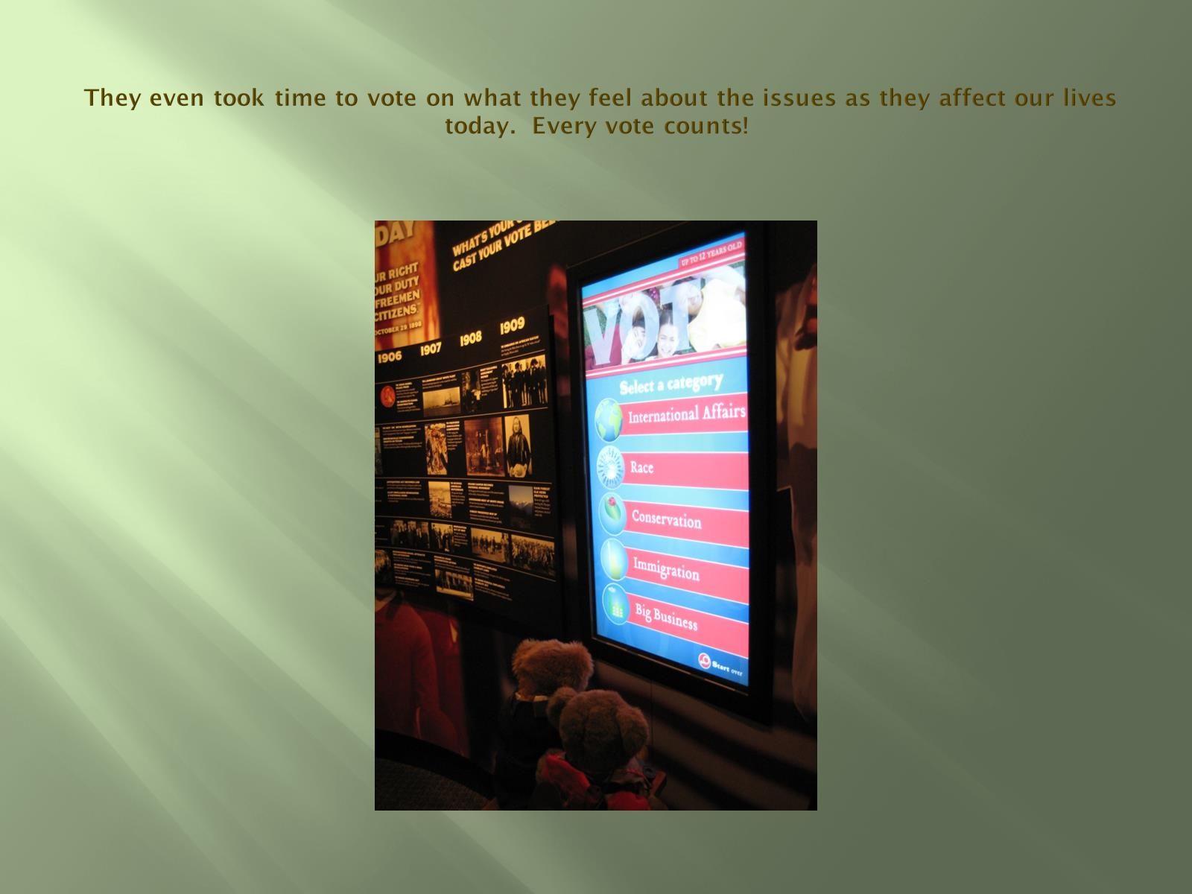
They even took time to vote on what they feel about the issues as they affect our lives today. Every vote counts!

Slide 38
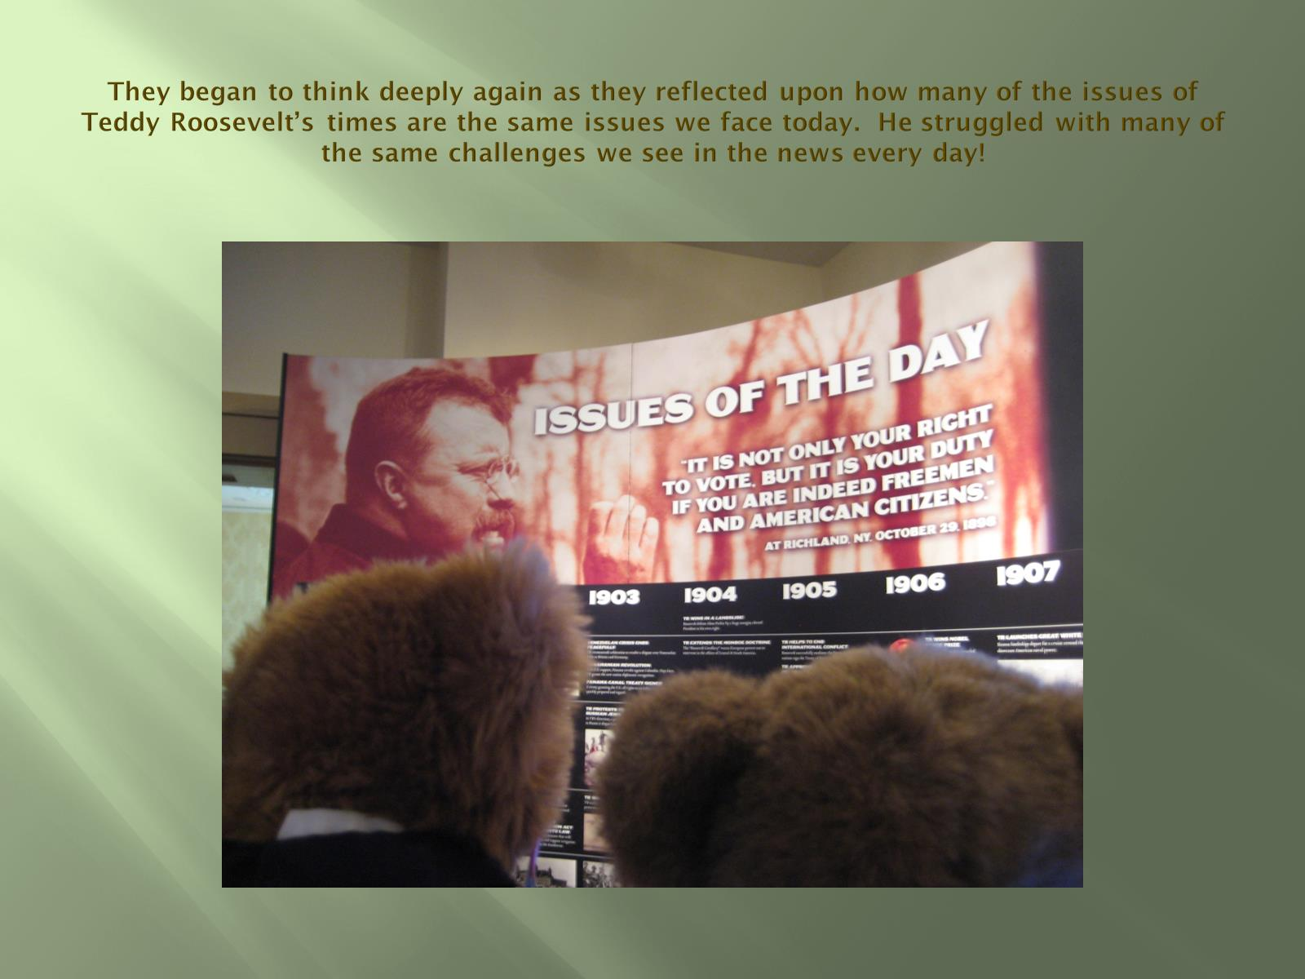
They began to think deeply again as they reflected upon how many of the issues of Teddy Roosevelt’s times are the same issues we face today. He struggled with many of the same challenges we see in the news every day!

Slide 39
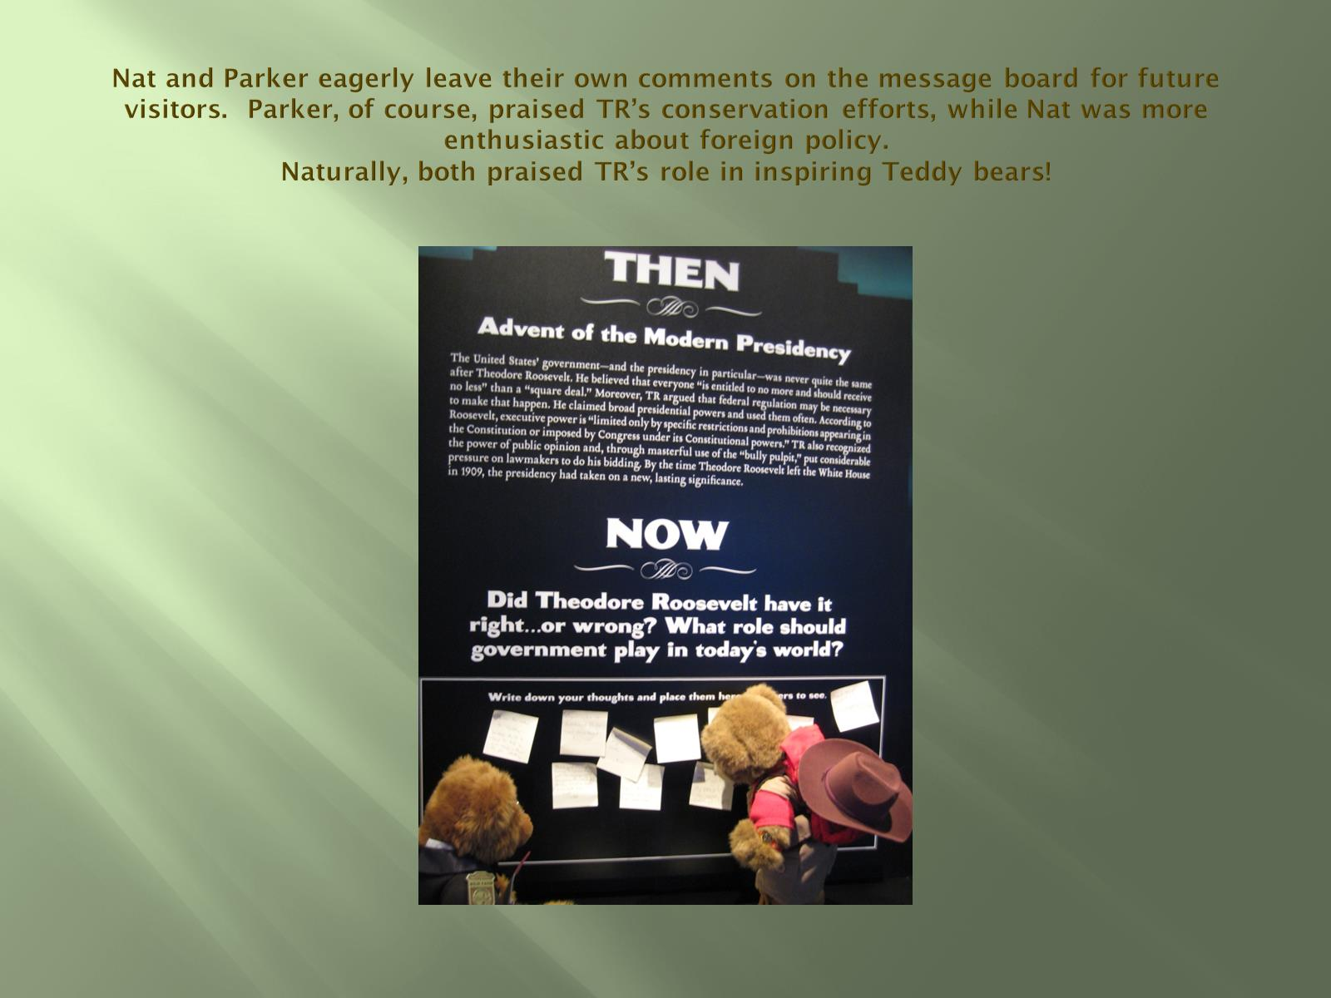
Nat and Parker eagerly leave their own comments on the message board for future visitors. Parker, of course, praised TR’s conservation efforts, while Nat was more enthusiastic about foreign policy.
Naturally, both praised TR’s role in inspiring Teddy bears!

Slide 40

One of their comments.

Slide 41
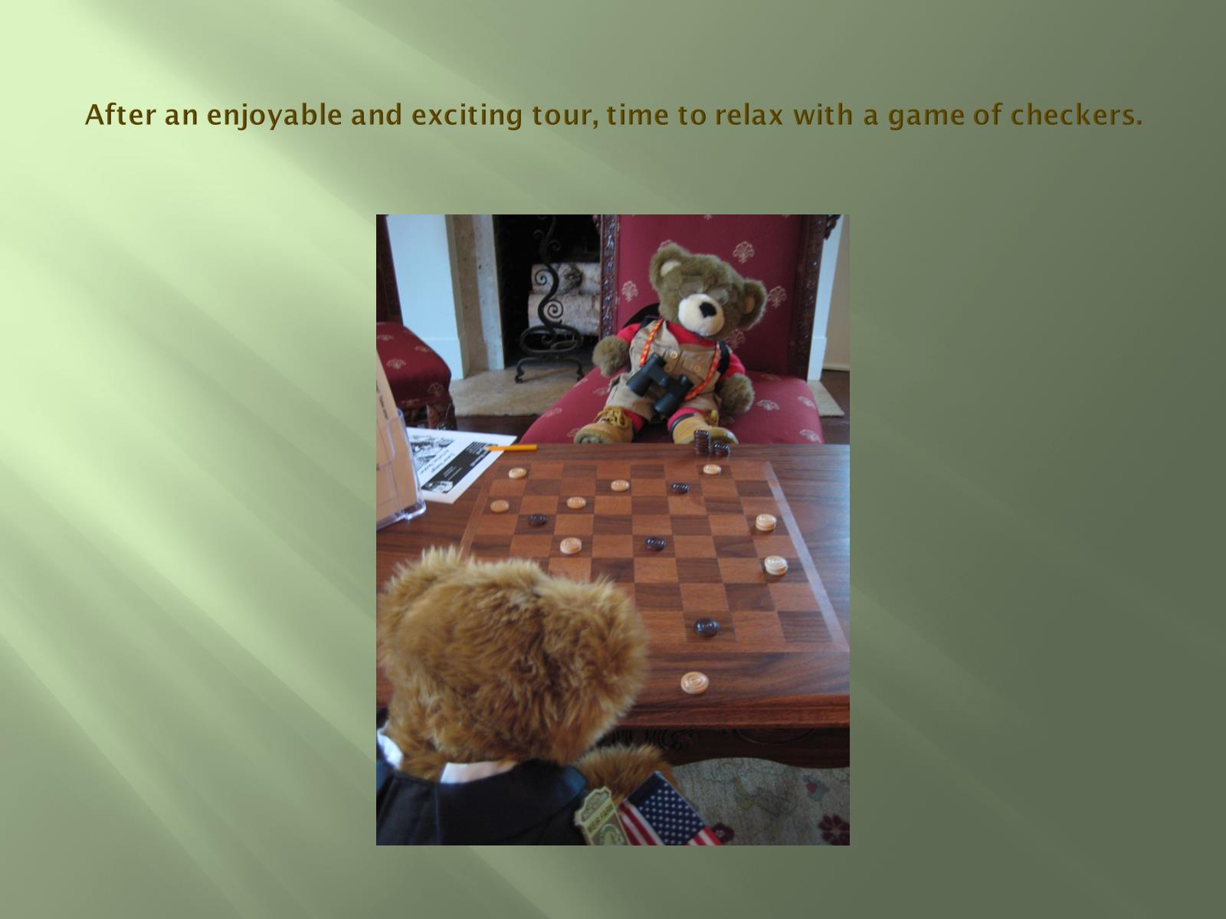
After an enjoyable and exciting tour, time to relax with a game of checkers.

Slide 42
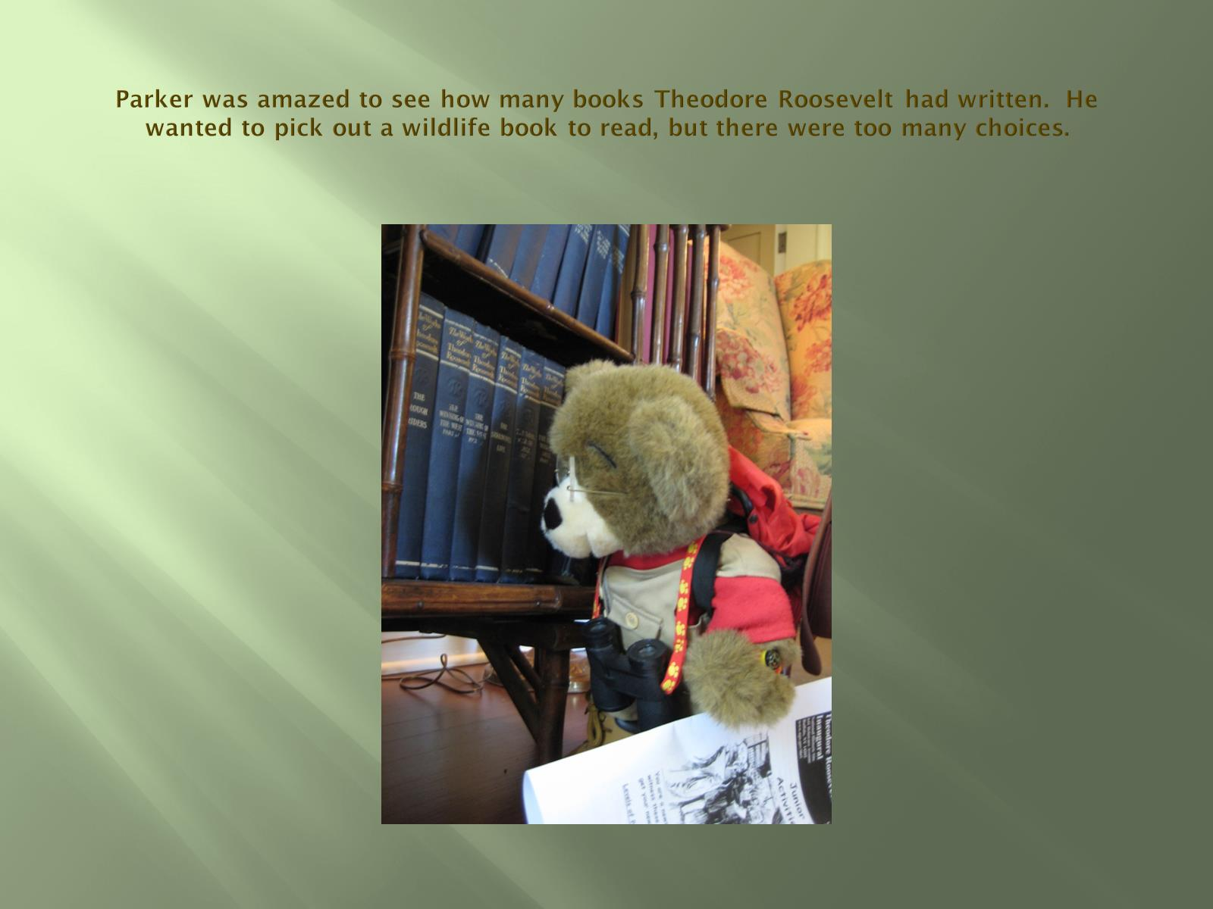
Parker was amazed to see how many books Theodore Roosevelt had written. He wanted to pick out a wildlife book to read, but there were too many choices.

Slide 43
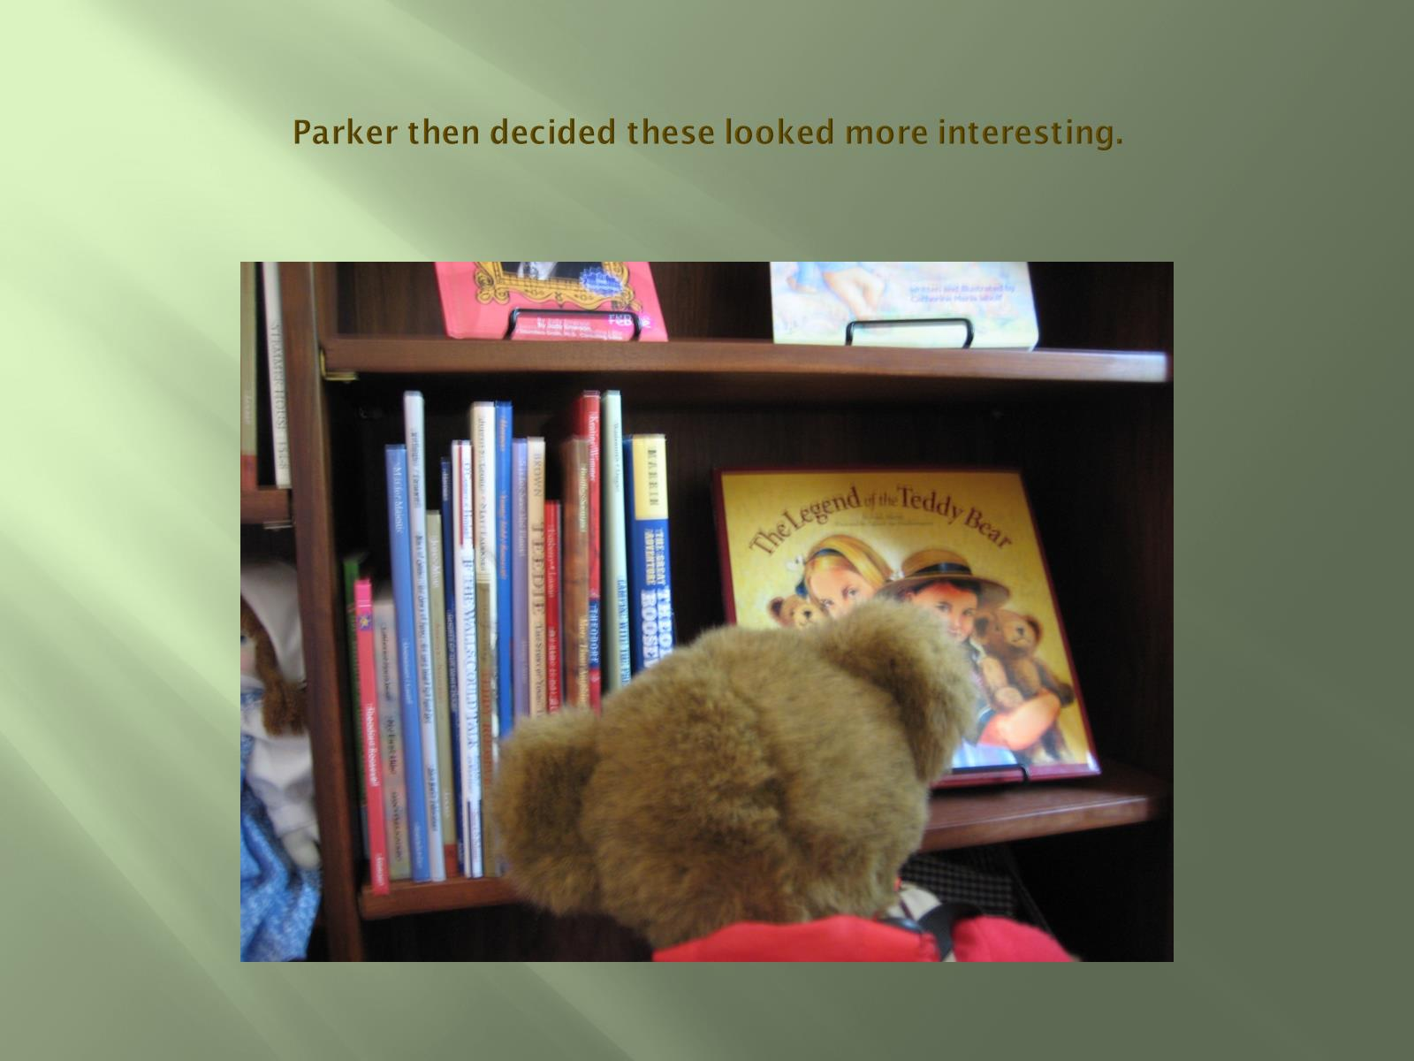
Parker then decided these looked more interesting.

Slide 44
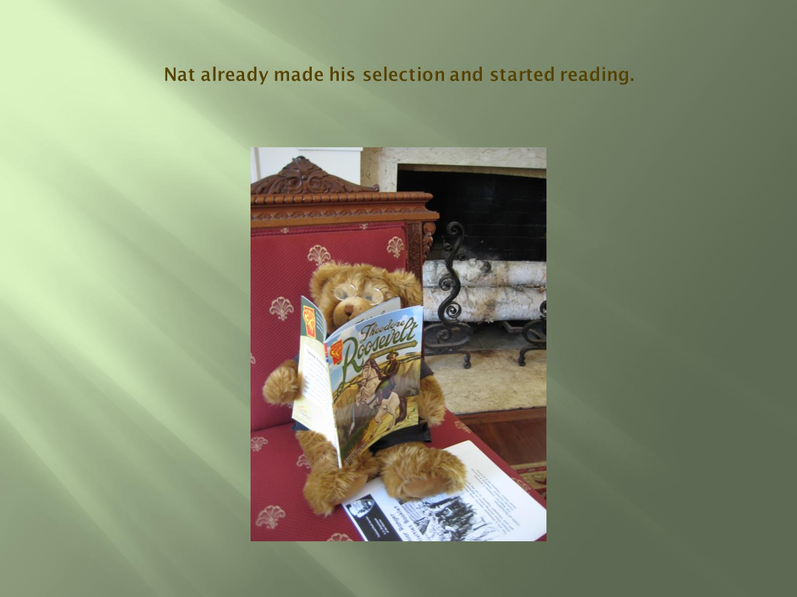
Nat already made his selection and started reading.

Slide 45
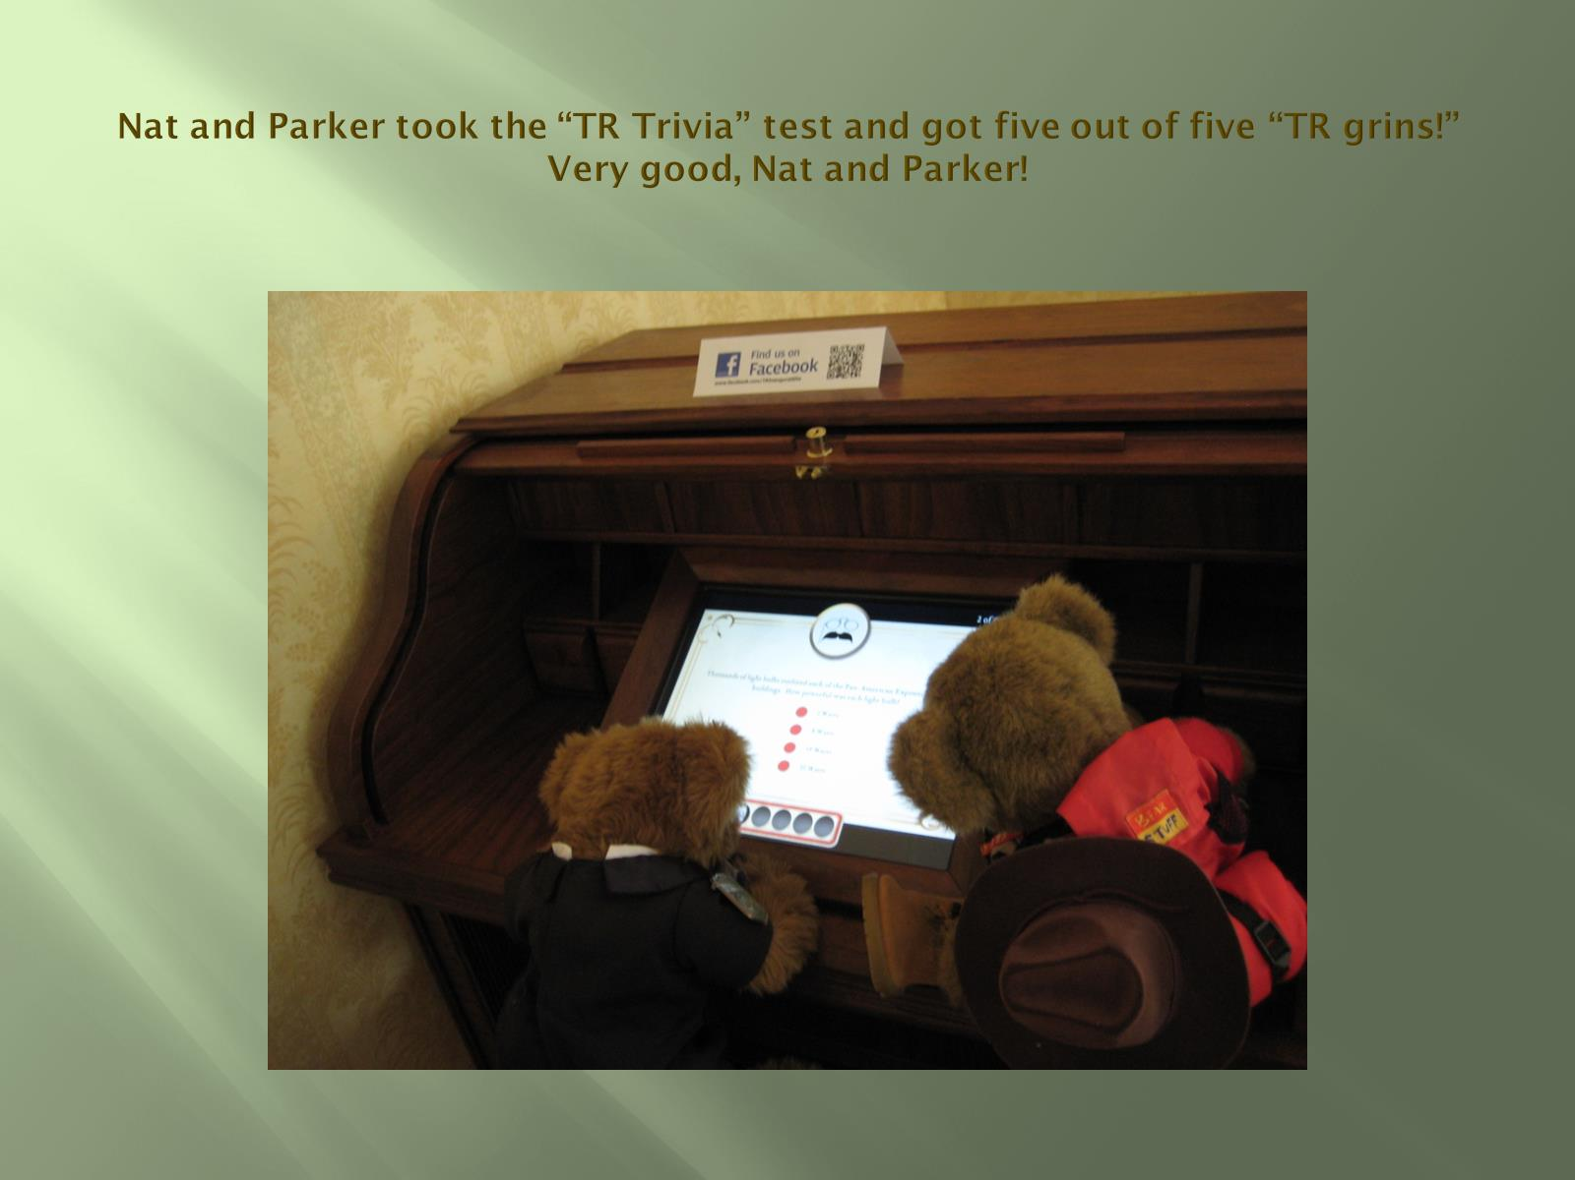
Nat and Parker took the “TR Trivia” test and got five out of five “TR grins!” Very good, Nat and Parker!

Slide 46
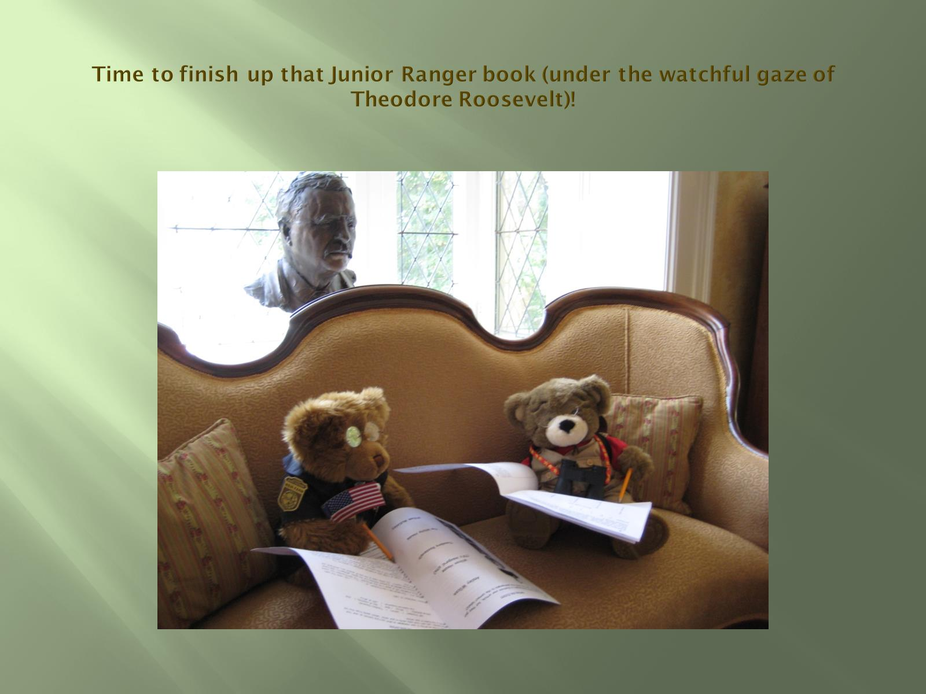
Time to finish up that Junior Ranger book (under the watchful gaze of Theodore Roosevelt)!

Slide 47
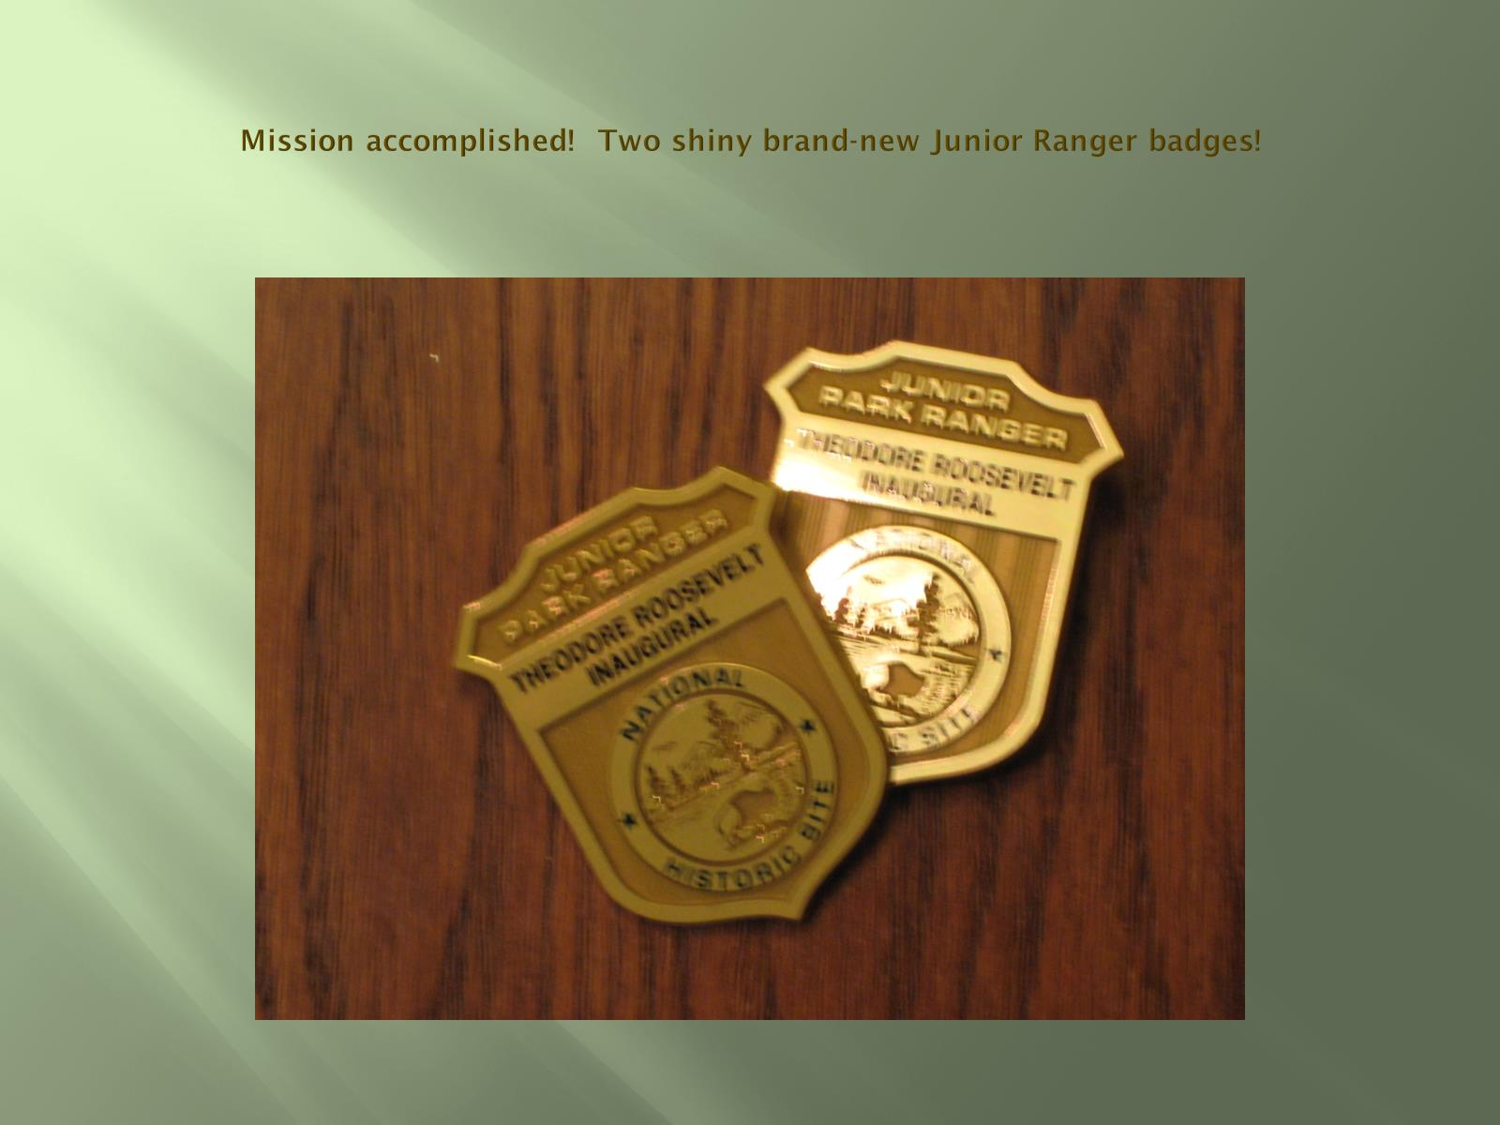
Mission accomplished! Two shiny brand-new Junior Ranger badges!

Slide 48
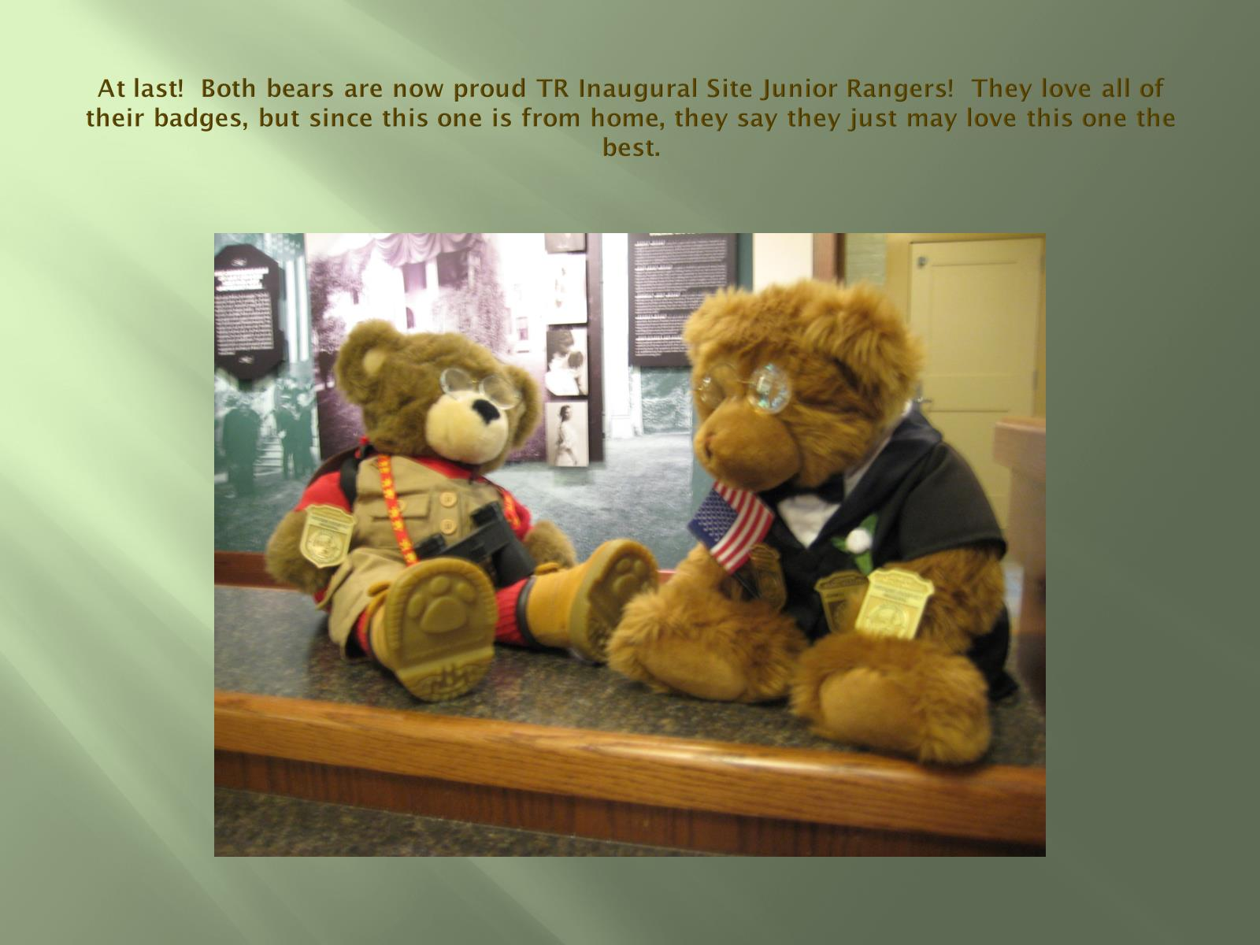
At last! Both bears are now proud TR Inaugural Site Junior Rangers! They love all of their badges, but since this one is from home, they say they just may love this one the best.

Slide 49
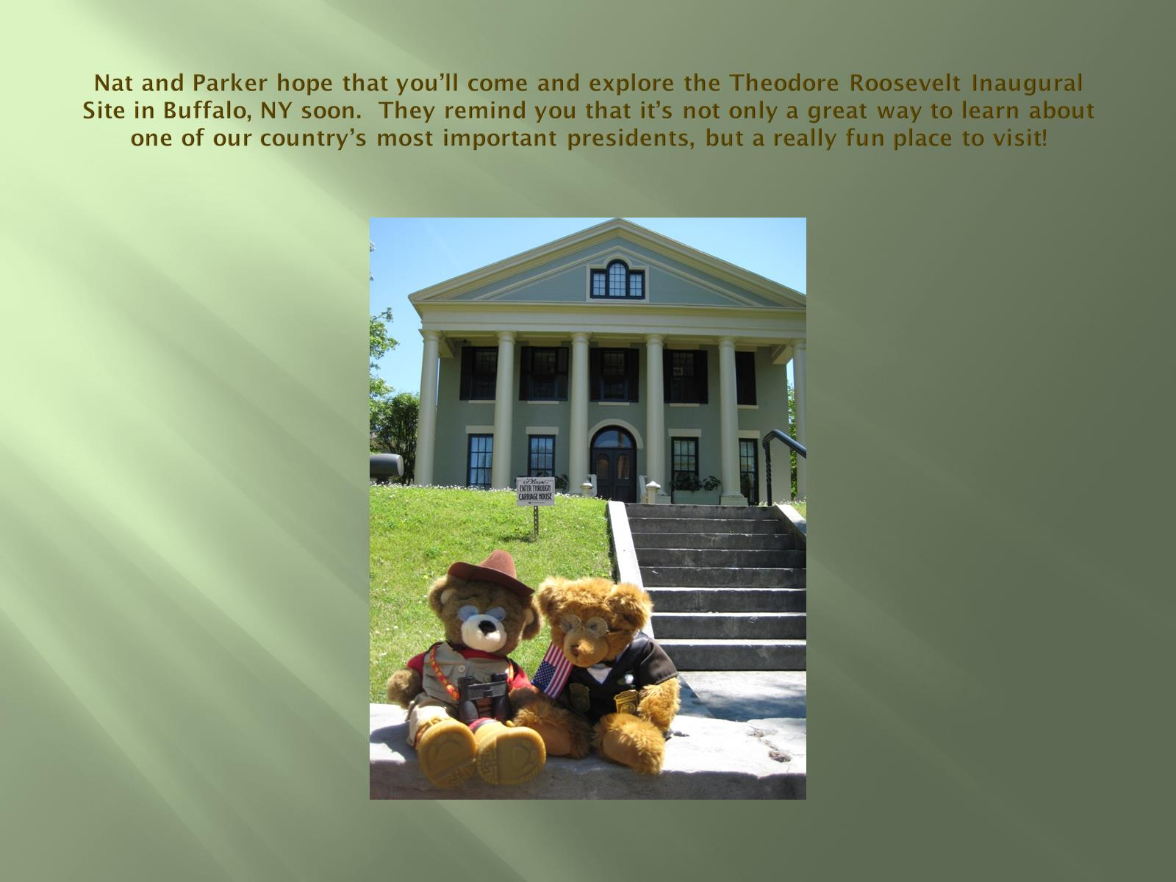
Nat and Parker hope that you’ll come and explore the Theodore Roosevelt Inaugural Site in Buffalo, NY soon. They remind you that it’s not only a great way to learn about one of our country’s most important presidents, but a really fun place to visit!

Slide 50

Come soon! www.trsite.org

